Slide 1

OTMW –Module5
University of Piraeus
The MEGI engine
Giorgos Plevrakis
Head of Power Plant and Turbomachinery
MAN Diesel & Turbo Hellas

Slide 2
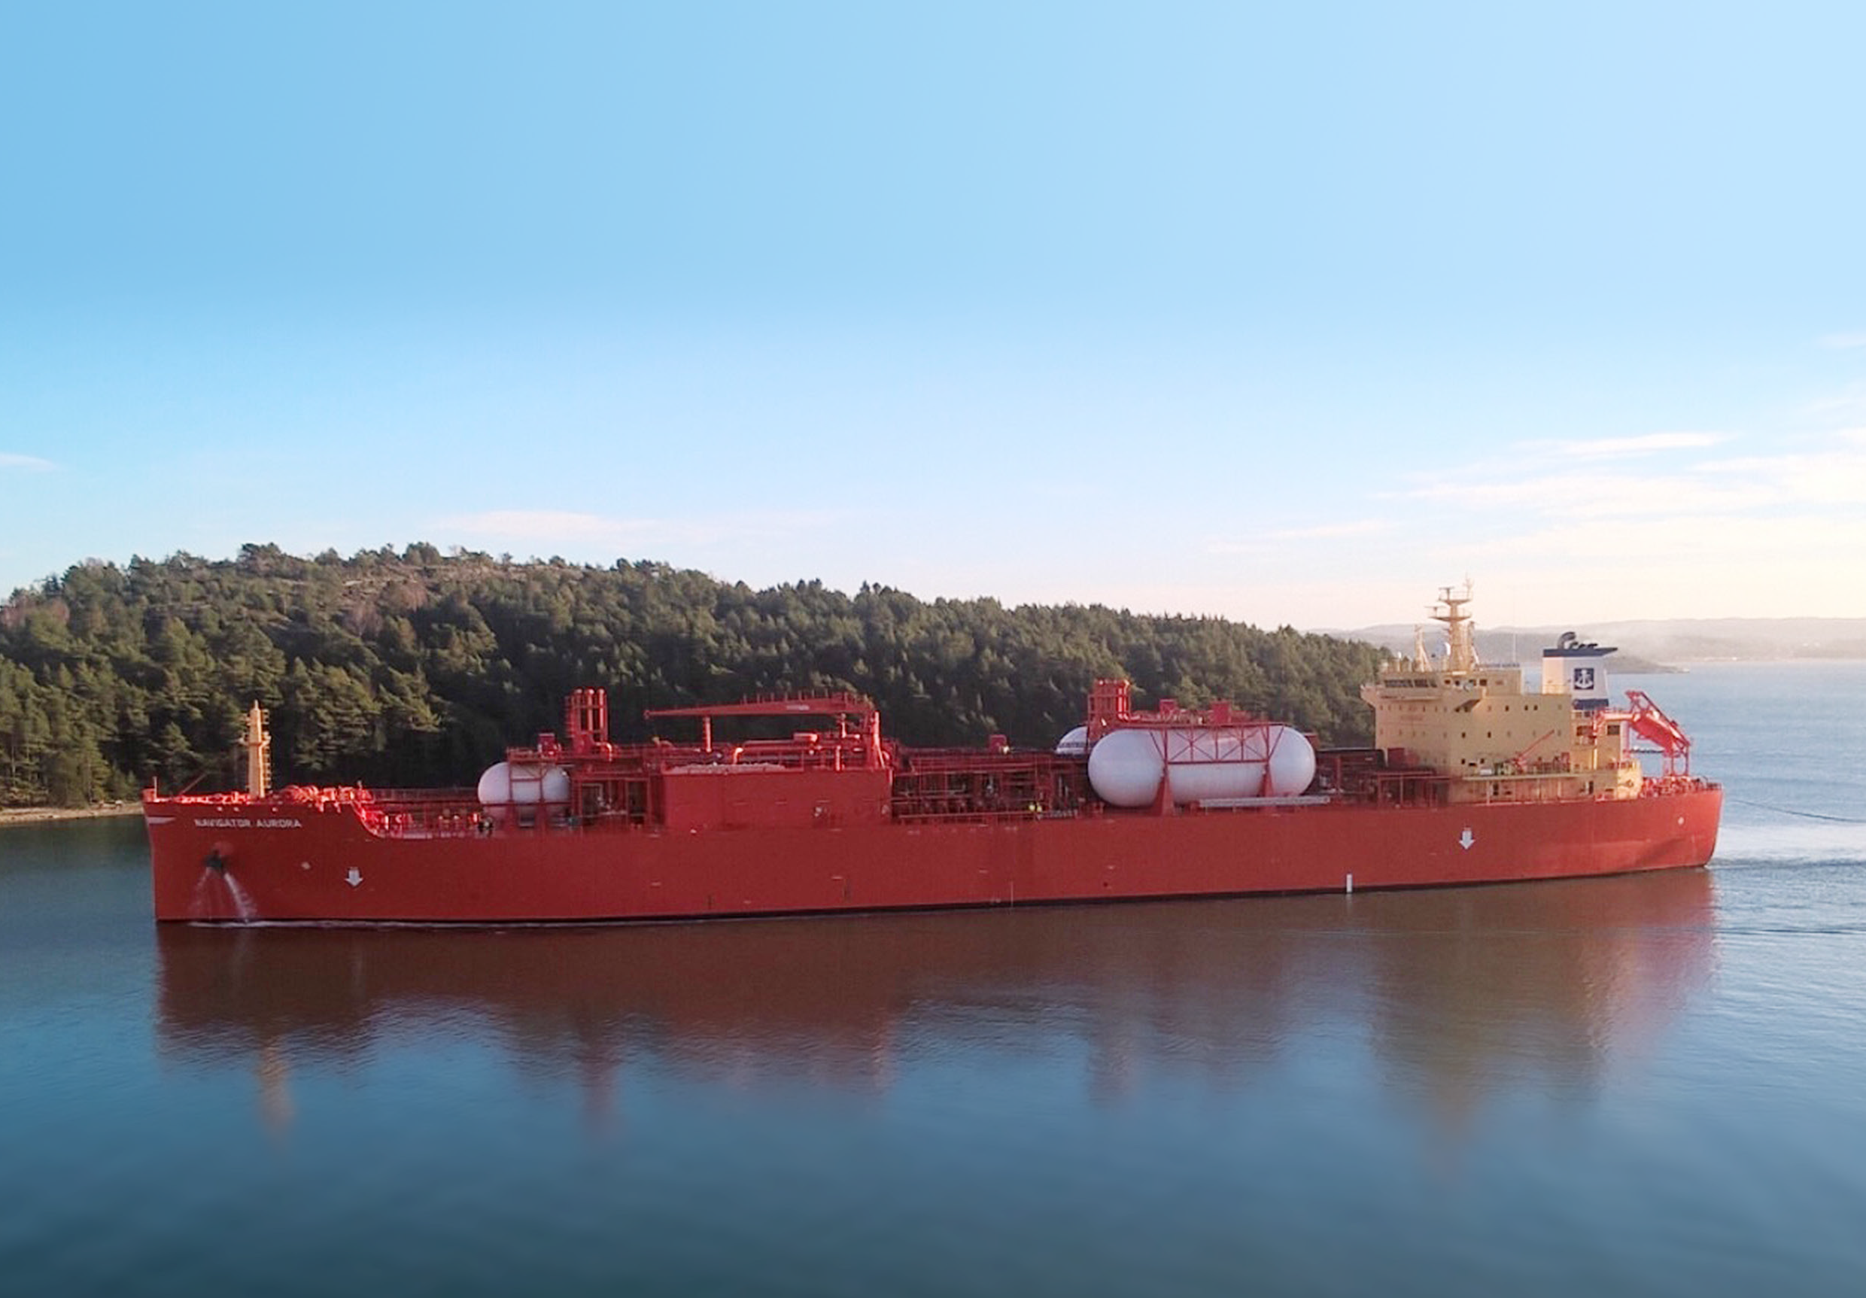




Cost-Optimised Designs of ME-GI Fuel Gas Supply Systems

Slide 3
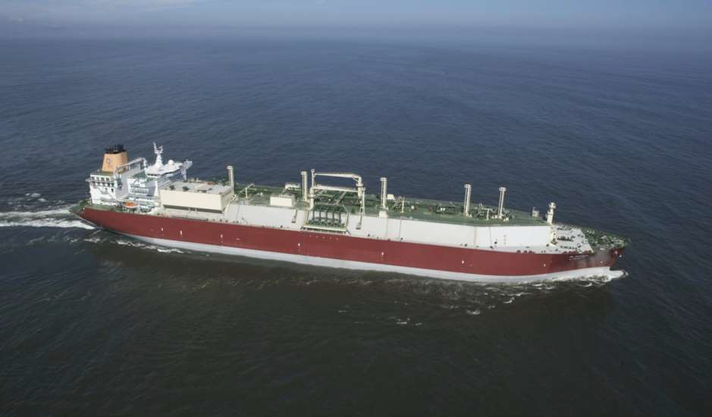



The World’s First ME-GI Retrofit Project
Service Delivery Test November 2015
Gas Valve Train
(GVT)
Q-Max
• 266.000 m³ LNG
Length: 345 m
Breadth: 54 m
Depth: 27 m
Fuel Gas Supply System (FGSS)
Conversion of 2 x 7S70ME-C
to
ME-GI engine x 2
Submerged LNG feed pumps in cargo tank 4 + 5
MAN Diesel & Turbo
3339676.2014.11.12
< 24 >

Slide 4
Gas valve leakage system
Gas channel pressure sensor
Gas control block
HC
Hydraulic oil
WV
Inert gas system
Sealing oil
HC
Double pipe
ventilation
LNG
tank
FS
HP
VP
Open air
Engine room
MAN Diesel & Turbo
< 4 >

Slide 5
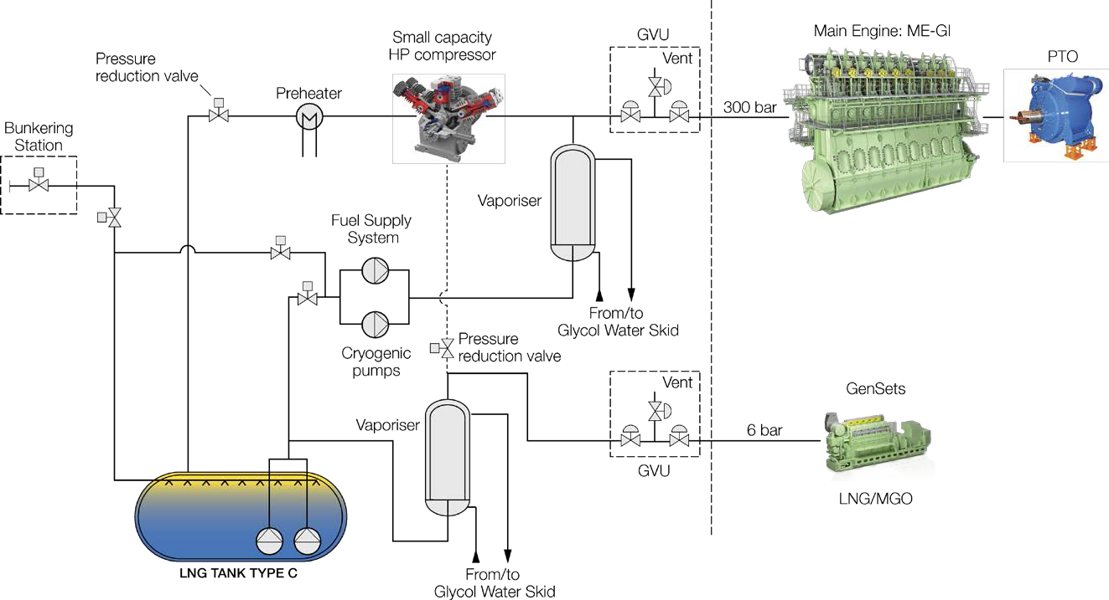
FGSS with PTO and small BOG compressor
Electric power generated by the ME-GI
One Genset on DF for harbour operation – BOG by side stream
MAN Diesel & Turbo
< 5 >

Slide 6
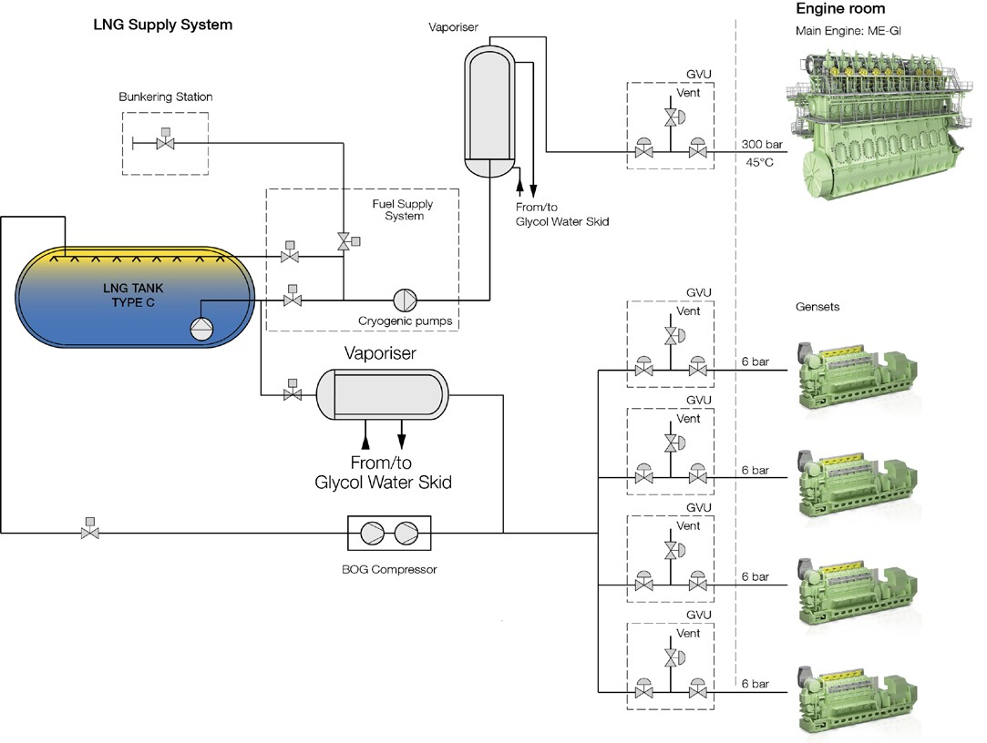
Typical Fuel Gas Supply System
For non-LNG Carriers
4 x 9L28/32DF
MAN Diesel & Turbo
< 6 >

Slide 7
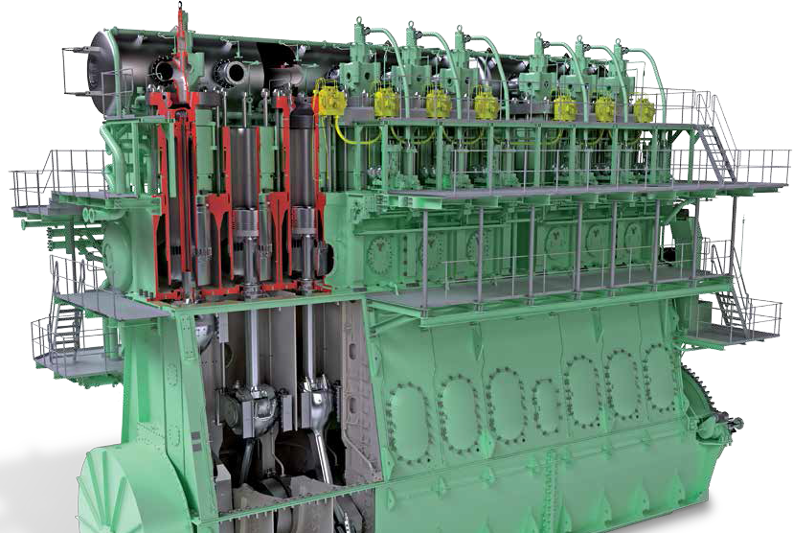




ME-GI Dual Fuel
MAN B&W Engines
A Technical, Operational and Cost-effective Solution for Ships Fuelled by Gas

Slide 8
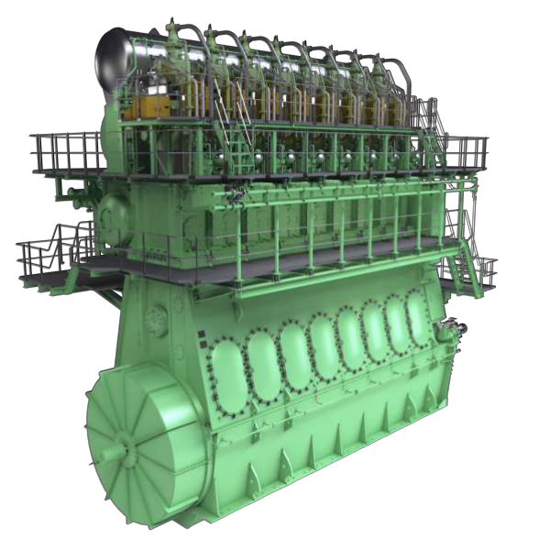
Dual Fuel engine design
ME-GI /ME-LGI
RSL
3338928.2013.12.12
❶❷❸❹
< 9 >

Slide 9
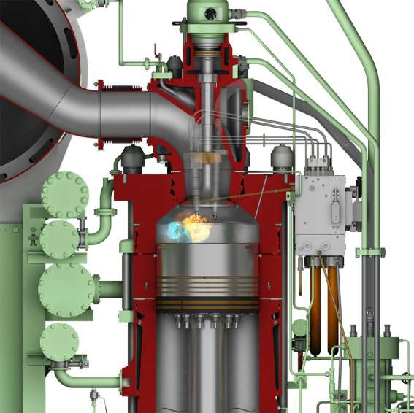
ME-GI
Combustion Concept
1
From actual footage (colorized)
Yellow = pilot oil
Blue = gas fuel
2
Conventional slide fuel valve
3
3 Gas fuel valve
2
4
4
Gas distribution channel (yellow)
5
Gas distributor block
5
1
6
Gas chain link double-walled pipes
6

Slide 10
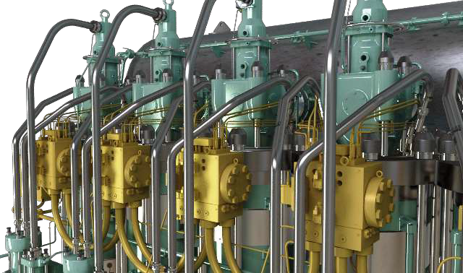
ME-GI Design
Chain Link Double Walled Gas Supply Pipes

Slide 11
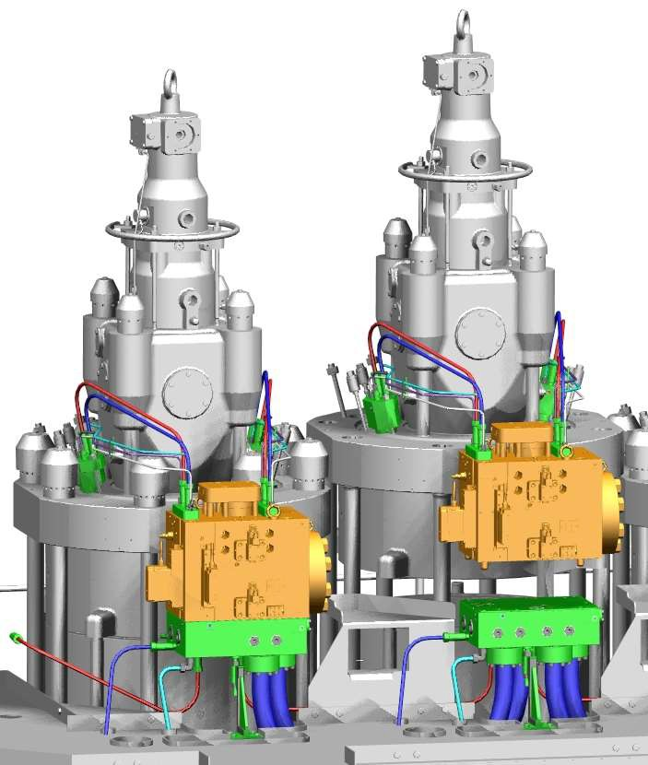
ME-GI Gas control block
Gas control block

Slide 12
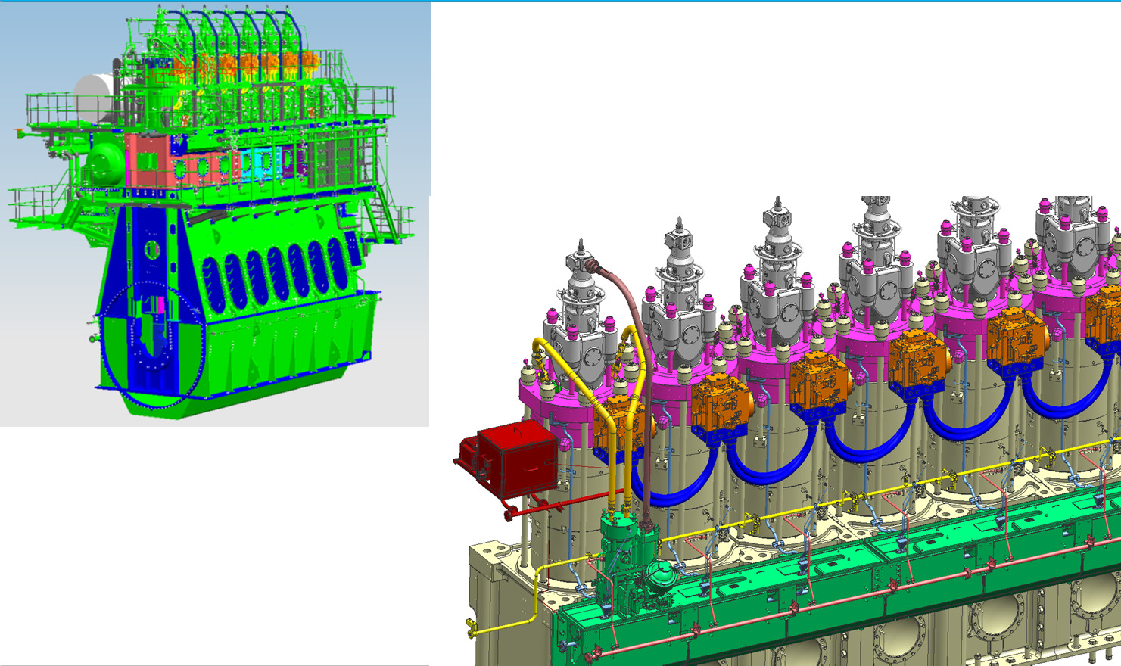
ME-GI Design updates Overview
More compact design introduced
2012.03.05
(RSL/LSP)
© MAN Diesel & Turbo
< 12 >

Slide 13
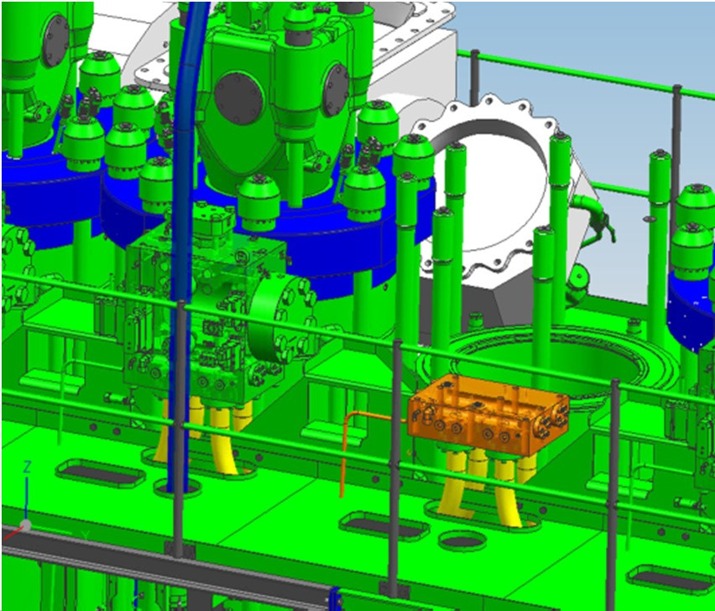
ME-GI Design updates Easy maintenance
All connections through adapter block
Gas inlet
Gas outlet
Hydraulic oil
Sealing oil
Hydraulic oil drain
Oil drain window/gas-valve
Low pressure oil
Connector block with pipes, remains on the engine during cylinder cover dismantling
2012.03.05
(RSL/LSP)
© MAN Diesel & Turbo
< 13 >

Slide 14
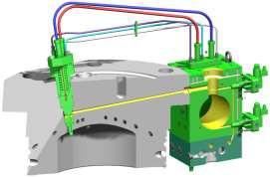
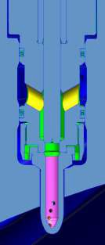
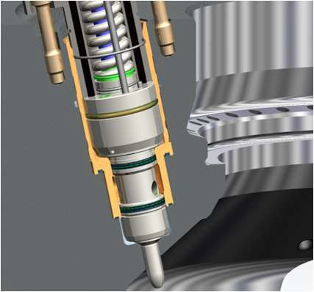
ME-GI gas injection sealing
Sealing Solutions for GI-valve in Cylinder Cover
Naming of tested sealing solutions:
❑ “Bare” covers
❑ Chrome plating in cover
Hartchrom
Jonghap
❑ Hardened bushing
Chrome plating in cover – radial interface to cover
Hardened bushing – axial interface to cover
Radial PTFE U-cup seal
Radial PTFE U-cup seal
Axial PTFE U-cup seal

Slide 15
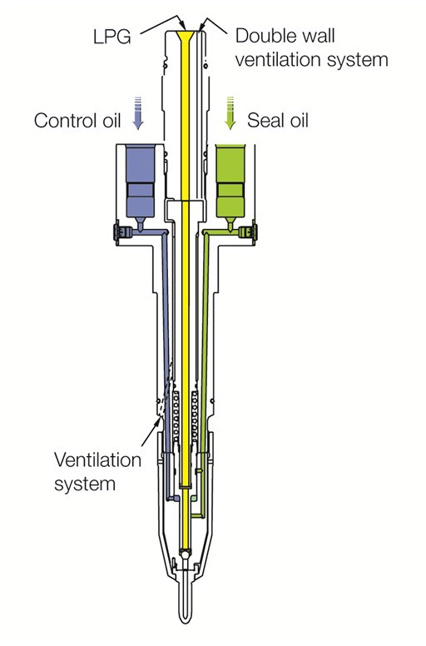
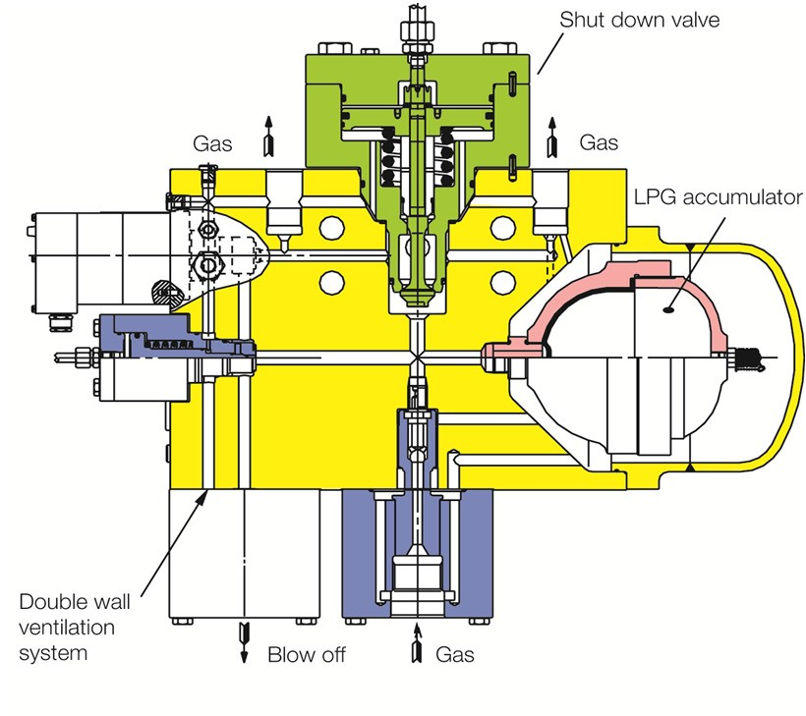
LPG as Fuel: Gas Injection Valve & Valve Block with Accumulator
2012.03.05
(RSL/LSP)
© MAN Diesel & Turbo
< 15 >

Slide 16
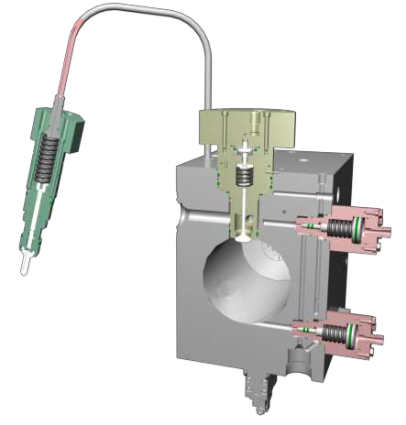
ME-GI
Gas Injection Control
Interlocked Gas Injection Sequence
Window Valve
Gas Injector
Gas Control Block Gas Channel

Slide 17
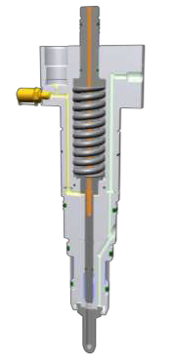
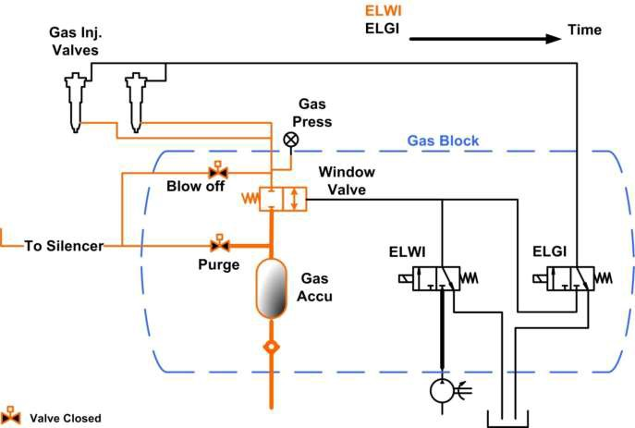
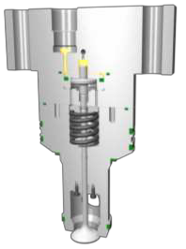
ME-GI
Gas Injection Control
Interlocked Gas Injection Sequence
Before gas injection
Closed gas injector
Closed window valve

Slide 18
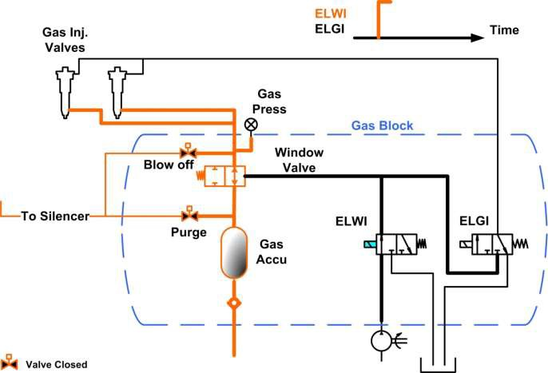
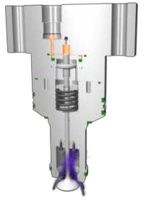
ME-GI
Gas Injection Control
Interlocked Gas Injection Sequence
Window opens
Closed gas injector
Open window valve

Slide 19
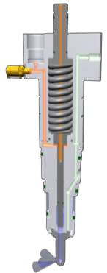
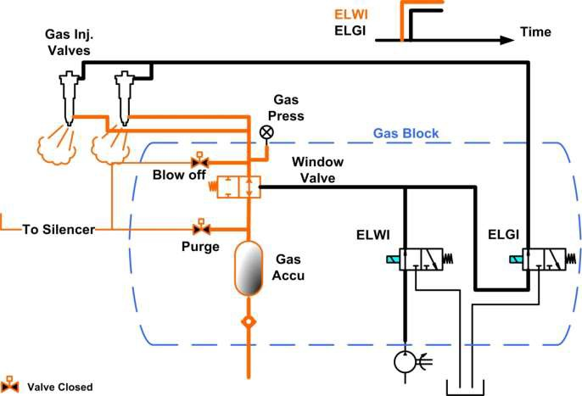
ME-GI
Gas Injection Control
Interlocked Gas Injection Sequence
Gas injection
Open gas injector
Open window valve

Slide 20
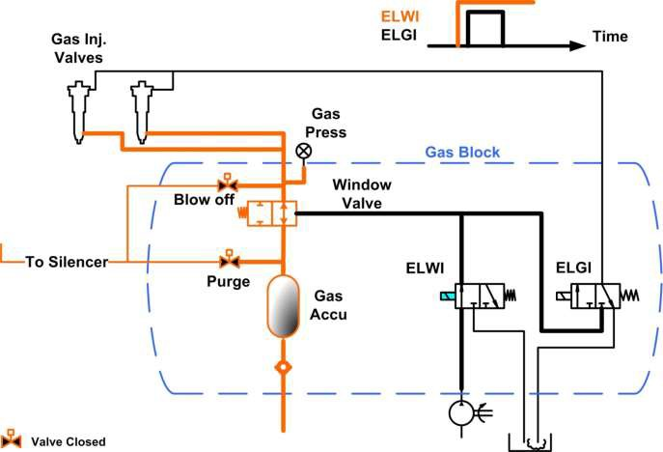
ME-GI
Gas Injection Control
Interlocked gas injection sequence Gas injection ends
Closed gas injector
Open window valve

Slide 21
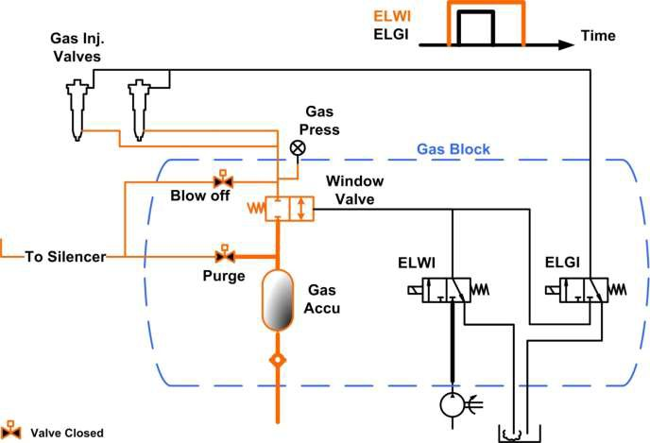
ME-GI
Gas Injection Control
Interlocked gas injection sequence
Window closes – cycle finished
Closed gas injector
Closed window valve

Slide 22
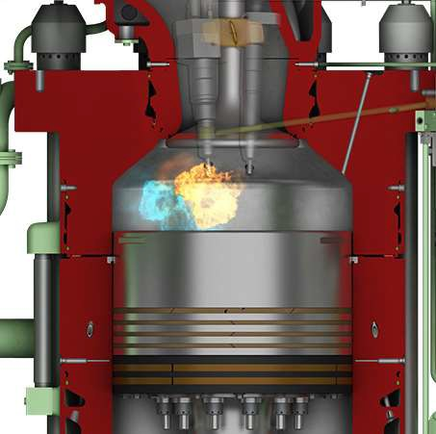
ME-GI Combustion Principle
The ME-GI engine is a
dual fuel engine
Diesel combustion process →
High effciency
Main injection
Pilot injection
< 21 >

Slide 23

ME-GI Gas Fuel Mode Port to port in gas mode
Fuel oil only mode
Operation profile as conventional engine
100%
90%
Gas fuel operation mode
No methane slip
No knocking problems
Insensitive to gas fuel
Unchanged load response
80%
70%
60%
Fuel Index
50%
% Total
% Pilot
40%
Gas Fuel
30%
20%
10%
Pilot oil
5 10
0
15
20
25
30
35
40 45 50 55 60
Engine Load (%SMCR)
65
70
75
80
85
90
95 100
0%
2012.03.05
(RSL/LSP)
© MAN Diesel & Turbo

Slide 24
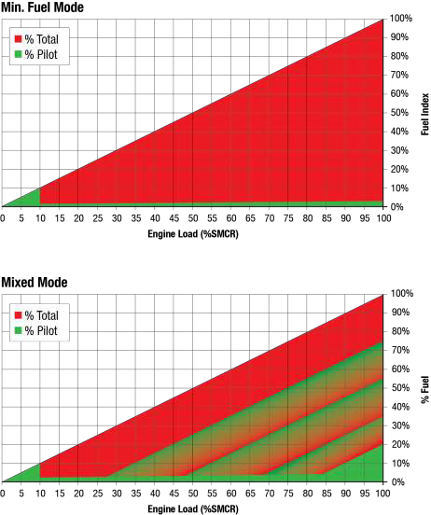
ME-GI Gas Fuel Mode
Port to port in dual fuel mode
Fuel oil only mode
Operation profile as conventional engine
Dual fuel operation mode
No fuel slip
No knocking problems
Insensitive to gas fuel
Unchanged load response
News:
Reduced pilot oil amount 5% → 3% Reduced load on gas → 10% load
RSL-LSP
3338912.2013.12.10
❶❷❸❹
< 23 >

Slide 25
The World’s First ME-GI Retrofit Project
Service Delivery Test November 2015
Gas Valve Train
(GVT)
Q-Max
• 266.000 m³ LNG
Length: 345 m
Breadth: 54 m
Depth: 27 m
Fuel Gas Supply System (FGSS)
Conversion of 2 x 7S70ME-C
to
ME-GI engine x 2
Submerged LNG feed pumps in cargo tank 4 + 5
3339676.2014.11.12
< 24 >

Slide 26
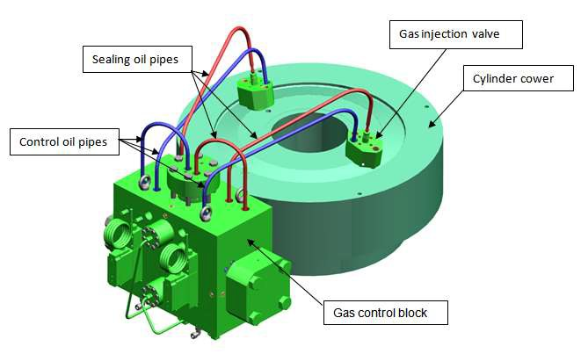
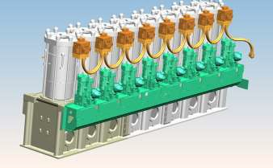
Engine Retrofit
From ME to ME-GI engine
Changed or modified item
Cylinder covers
Engine hydraulic system
Exhaust valves
Fuel oil high pressure pipes
Additonal item
Gas Control Block complete
Gas injector valves
Sealing oil unit
Control- and sealing oil pipes
Atomizers for fuel injector valves
Gas pipe arrangement on engines
Control and safety system (GI-ECS)
Double-walled gas pipe

Slide 27
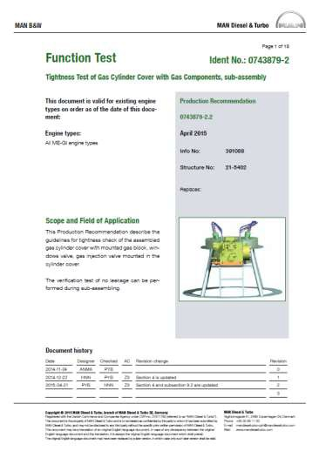
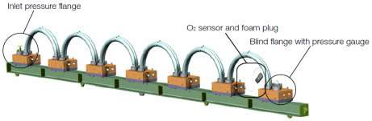
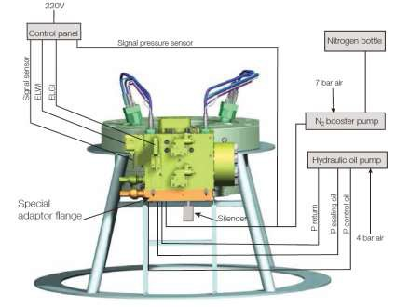
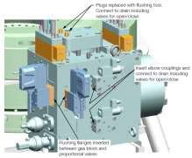

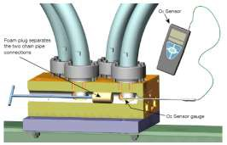
ME-GI Production Support
Test Bed Experiences: Pre-Function Test of Main Gas Components
Exper
Le
Flus
Func
Proc
Dev
ience show advantages for introducing pre-func
akage test
Verification of leakage tightness during sub-assembly hing of components
Windows valve, hydraulic pipe, gas block
tion test
Test of connections and activating of Windows Valve, Gas edures for sub assembled components
elopment of pre-function test procedures
tion tests for main gas components before instalation on engine.
Injection Valve, Purge/Blow-off Valve

Slide 28
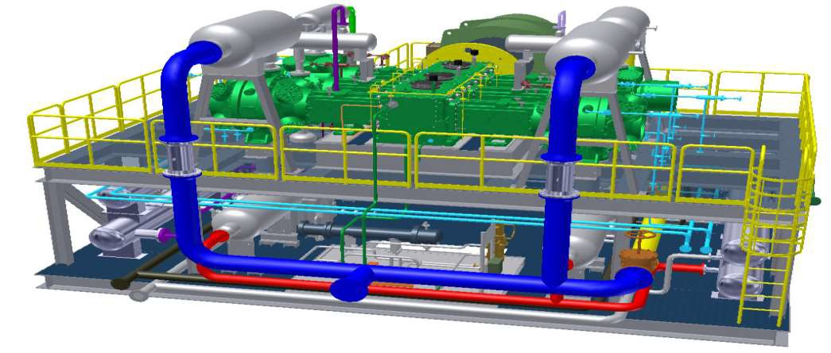
New compressor makers MES
MES
High Pressure Gas Compressor

Slide 29
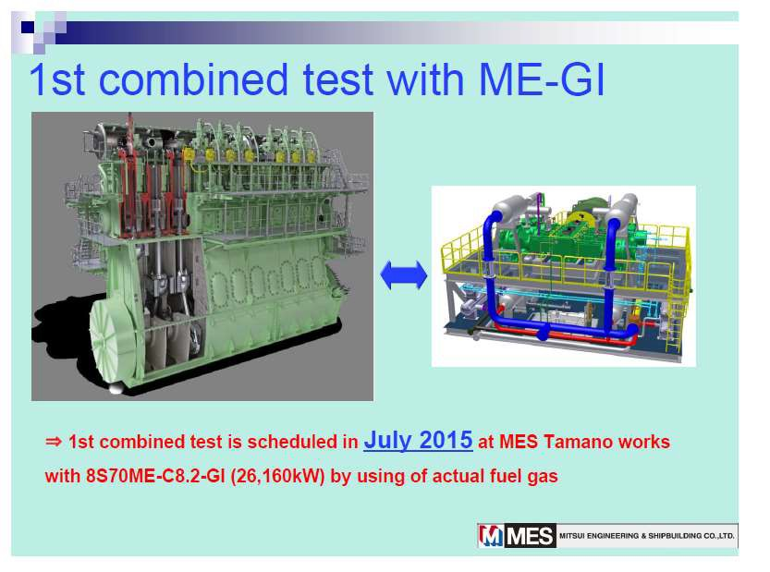
New compressor makers MES

Slide 30
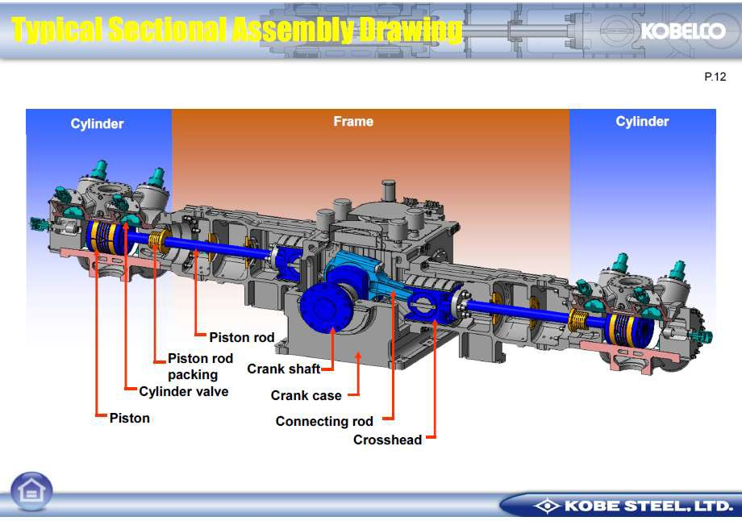
New compressor makers Kobelco

Slide 31
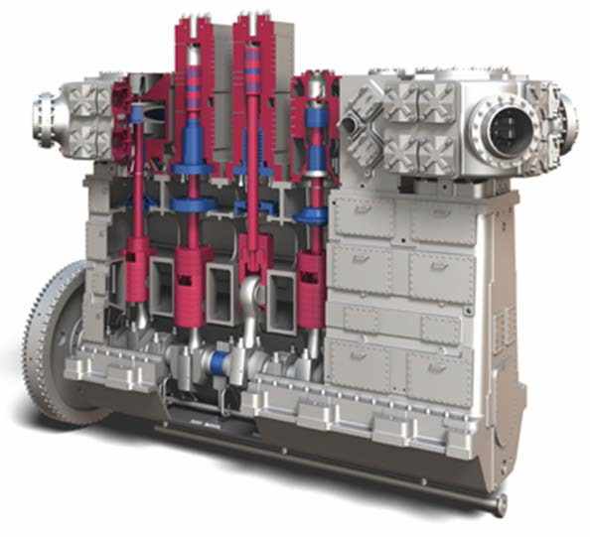
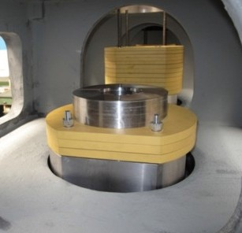
Burckhardt Laby®-GI
Fuel gas compressor type 6LP250-5S
Combining LNG BOG and high pressure process compression technology
Optimal selection of compressor sealing system
Fully balanced, single casing, slow speed vertical frame design
Gas-tight compressor casing
Ring sealed 4th to 5th stage
Labyrinth 1st to 3rd stage
Labyrinth 1st stage
Balancing weights
Laby®-GI
MAN Diesel & Turbo
RSL
3338935.2013.12.12
❶❷❸❹
< 4 >

Slide 32

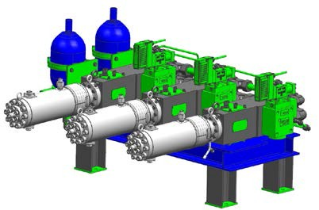
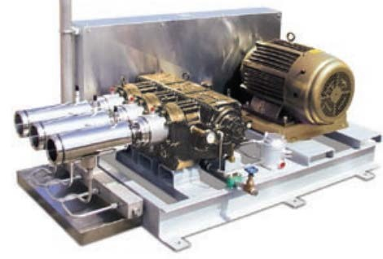
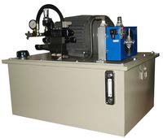
MDT cryogenic pump
MDT
Hydraulic powerpack and piston with embedded redundancy
Competitors
Electric motor and Crankshaft with no embedded redundancy
Electric motors in Ex proof zone
HPS in safe zone
MAN Diesel & Turbo
< 32 >

Slide 33
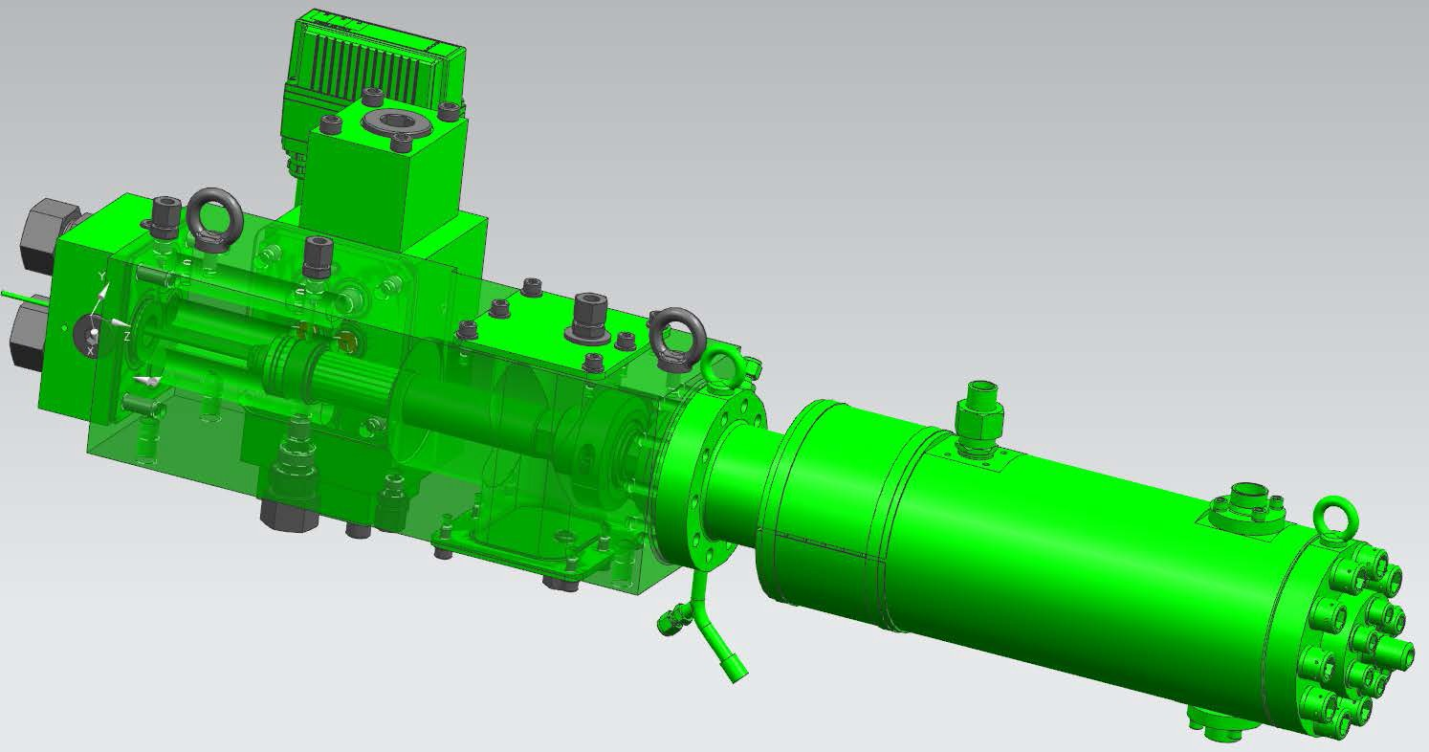
FGSS from MDT - 2016
Concept - using the hydraulic booster
Hydraulic distribution block
EX proofed MOOG valve
Elva on-off
Cold-End
Plunger section
Dimensions: (1100 x 350 x 350 mm)
MAN Diesel & Turbo
< 33 >

Slide 34
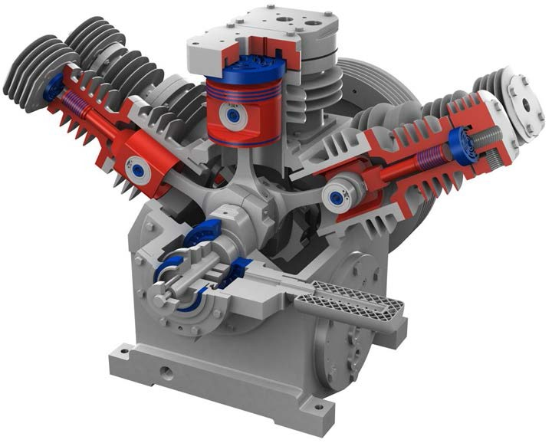

Fuel Gas supply to ME-GI.
Standard High Pressure (SHP): delivery at 310 bar.
Multi-stage high pressure design for:
Natural Gas (CNG) fueling station
HP gas storage facilities
Fuel gas supply for LNGC’s
Merchant LNG fueled shipping
Gas tight crankcase
Air or water cooled design Zero gas loss
Anti - vibration mounting
More than 700 installed SHP units
MAN Diesel & Turbo
< 34 >

