Slide 1
DIESEL ENGINE TROUBLESHOOTING
Athena Birbili

Slide 2
A. Match the terms to the explanations.
defective
solenoid valve
faltering
sluggishness
alternatively
respectively
slow motion, idleness, inactivity
faulty
irregular running of the engine
as a second choice
electromagnetic valve
correspondingly, to the relevant one

Slide 3
A. Match the terms to the explanations.
defective
solenoid valve
faltering
sluggishness
alternatively
respectively
slow motion, idleness, inactivity: sluggishness
faulty: defective
irregular running of the engine: faltering
as a second choice: alternatively
electromagnetic valve: solenoid valve
correspondingly, to the relevant one: respectively

Slide 4
Starting difficulties
Engine fails to turn on starting air after START order has been given

Slide 5
Possible cause Remedy
1. Pressure in starting air r__ too low. Start the c__. Check that they are
working properly.
2. Valve on starting air receiver closed. O__ the valve.
3. Valve to starting air d__ closed. Open the valve.
4. No pressure in the c__ air system. Check the pressure (normally 7 bar).
If too low, change o__ to the other
reducing v/v and clean the f__.
5. Main starting v/v does not function Release the t__ gear locking device.
owing to activated t__ gear locking
device.
6. Pistons in starting air d__ sticking. L__ and make the pistons movable.
7. Distributor wrongly adjusted. Check the timing marks. Alternatively,
with the engine p__ 1 in TDC, check
that the s__ air distributor piston for cyl. 1 is lifted to the same h__ by, respectively, the AHEAD and ASTERN c__ of the starting air distributor.

Slide 6
Possible cause Remedy
1. Pressure in starting air receiver too Start the compressors. Check that they
low. are working properly.
2. Valve on starting air receiver closed. Open the valve.
3. Valve to starting air distributor closed. Open the valve.
4. No pressure in the control air Check the pressure (normally 7 bar).
system. If too low, change over to the other
reducing v/v and clean the filter.
5. Main starting v/v does not function Release the turning gear locking
owing to activated turning gear locking device.
locking device.
6. Pistons in starting air distributor Lubricate and make the pistons
sticking. movable.
7. Distributor wrongly adjusted. Check the timing marks. Alternatively,
with the engine piston 1 in TDC, check
that the starting air distributor piston for cyl. 1 is lifted to the same height by, respectively, the AHEAD and ASTERN cam of the starting air distributor.

Slide 7
Starting difficulties
Engine does not reverse when order is given

Slide 8
Possible cause Remedy
1. Defective starting air v/vs in P__-test the v/vs for leakages. cylinder c__. Replace or o__ the defective ones.
2. Propeller b__ are not on zero- Set pitch to zero position.
pitch. (CPP plants)
3. Coil of s__ v/v for the desired See the “B__ control” instruction
direction of r__ does not reach book.
the engine.
4. ‘Slow-turning’(option) of engine Set the ‘slow-turning’ adjustment
adjusted too l__. screw so that the engine turns as slowly as p__ without faltering.
5. Faulty t__ of starting air Check the t__.
distributor.

Slide 9
Possible cause Remedy
1. Defective starting air v/vs in Pressure-test the v/vs for leakages. cylinder covers. Replace or overhaul the defective ones
2. Propeller blades are not on Set pitch to zero position.
zero-pitch. (CPP plants)
3. Coil of solenoid v/v for the See the “Bridge control” instruction
desired direction of rotation does book.
not reach the engine.
4. ‘Slow-turning’(option) of engine Set the ‘slow-turning’ adjustment
adjusted too low. screw so that the engine turns as slowly as possible without faltering.
5. Faulty timing of starting air Check the timing.
distributor.

Slide 10
Starting difficulties
Engine turns on starting air but stops after receiving order to run on fuel

Slide 11
Possible cause Remedy
1. P__ v/vs not deaerated. Find the cause of the stop-order and correct the f__.
2. Shut-down of engine. Check p__ and t__. Reset “shut down”.
3. Sluggishness in the m__ gear. Lubricate the m__ gear. Ensure that the fuel pumps, rod connections and b__ are movable.
4. G__ air booster (Woodward) See the i__ manual.
does not supply o__ pressure
during the starting air period.
5. The pre-set s__ setting pressure The pressure shall be set
to the governor (Woodward), is set between 1.6 and 2.0 bar, and
too l__, or for a too short period. maintained for about 6 s__.
6. Fault in governor. Woodward governor Check that it functions with the correct oil p__. Check that the limiting functions are a__ correctly.

Slide 12
Possible cause Remedy
1. Puncture v/vs not deaerated. Find the cause of the stop-order and correct the fault.
2. Shut-down of engine. Check pressure and temperature. Reset “shut down”.
3. Sluggishness in the manoeuvring Lubricate the manoeuvring gear.
gear. Ensure that the fuel pumps, rod connections and bearings are movable.
4. Governor air booster (Woodward) See the instruction manual.
does not supply oil pressure
during the starting air period.
5. The pre-set speed setting pressure The pressure shall be set
to the governor (Woodward), is set between 1.6 and 2.0 bar, and
too low, or for a too short period. maintained for about 6 seconds.
6. Fault in governor. Woodward governor Check that it functions with the correct oil pressure. Check that the limiting functions are adjusted correctly.

Slide 13
Starting difficulties
Engine turns on fuel, but runs unevenly (unstable) and will not pick up rpm

Slide 14
Possible cause Remedy
1. Auxiliary b__ not functioning. Start auxiliary b__.
2. S__ air limit set at too h__ or Check level of s__ air pressure and
too low level. the e__ gas pressure at the actual
l__. Compare the pressures with
shop or sea t__ observations.
3. F__ filter blocked. Clean the filter.
4. Too low fuel pressure. I__ the pressure.
5. One or more cylinders not Check s__ v/v and puncture v/v in
f__. fuel p__.
Check individual index; if no index,
check the rod c__ and the safety
s__ -down system.
If fault cannot be found, c__ fuel v/vs.

Slide 15
Possible cause Remedy
1. Auxiliary blowers not functioning. Start auxiliary blowers.
2. Scavenge air limit set at too Check level of scavenge air
high or too low level. pressure and the exhaust gas
pressure at the actual load. Compare the pressures with
shop or sea trial observations.
3. Fuel filter blocked. Clean the filter.
4. Too low fuel pressure. Increase the pressure.
5. One or more cylinders not Check suction v/v and puncture
firing. v/v in fuel pump.
Check individual index; if no index,
check the rod connections and
the safety shut-down system.
If fault cannot be found, change fuel v/vs.

Slide 16
Running difficulties

Slide 17
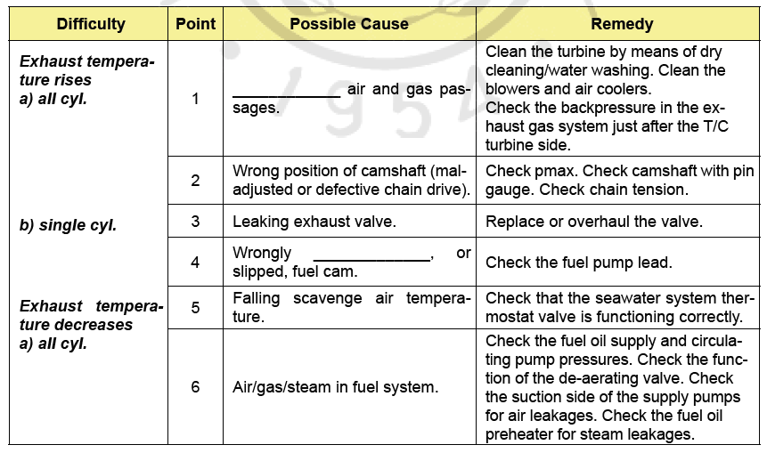
You will read a list of running difficulties, some possible causes and their remedies. Use the words below to fill in the gaps.
appear drain raise repair observed adjusted sticking fouled

Slide 18
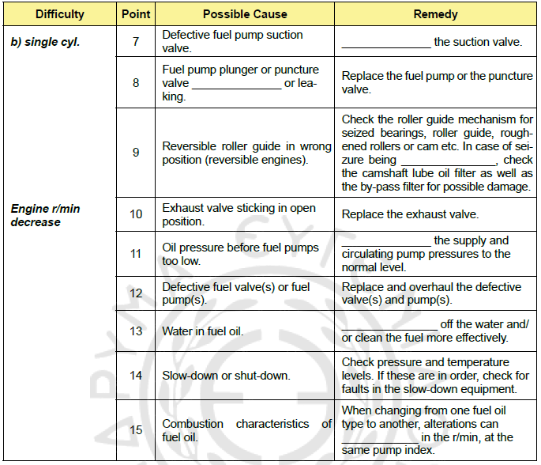
You will read a list of running difficulties, some possible causes and their remedies. Use the words below to fill in the gaps.
appear
drain
raise
repair
observed
adjusted
sticking
fouled

Slide 19
You will read a list of running difficulties, some possible causes and their remedies. Use the words below to fill in the gaps.
appear drain raise repair observed adjusted sticking fouled

Slide 20
You will read a list of running difficulties, some possible causes and their remedies. Use the words below to fill in the gaps.
appear
drain
raise
repair
observed
adjusted
sticking
fouled

Slide 21
Thank you!

