Slide 1
Sixth semester
AEN of Macedonia
Elli Xenitidou

Slide 2
Contents
Cylinder liner wear
01
Diesel Engine Troubleshooting
02
Refrigeration
03
04
Insulation
05
IMO SMCP : Handling liquid goods, bunkers and ballast pollution prevention
06
Review to
part three

Slide 3
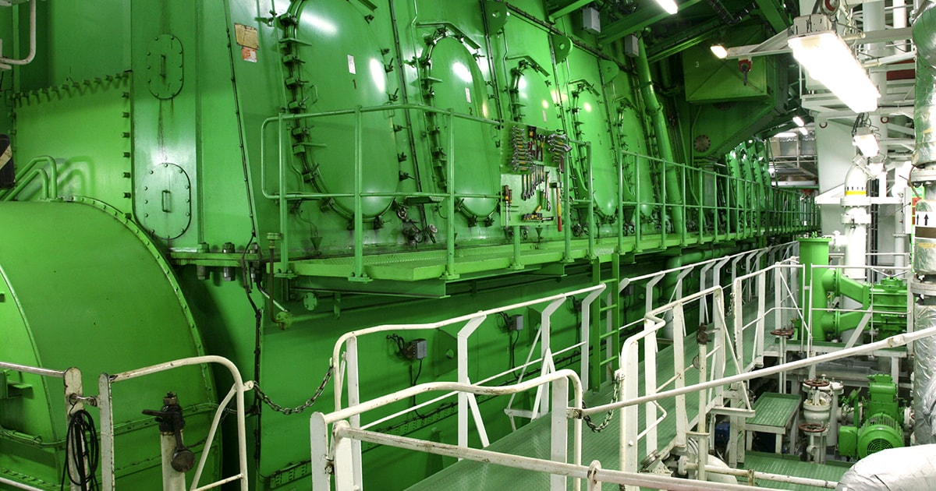
What are the synonyms of the following words?
Gauge- abrade, condense, measure
Bore- hole, thickness, aperture, rate (there are two)
Scuff- Mar, ruin, abrade, tear (there are two)
Abrade- insulate, weld, rub
Interval- rate, break, intermission, severeness(there are two)
Subsequent- ensuing, following, consecutive, precedent (there are three)
Tear- rupture, zip, rip up,
Condense- compact, coagulate, compress
Insulate- confine, wrap, reduce
Page 356

Slide 4
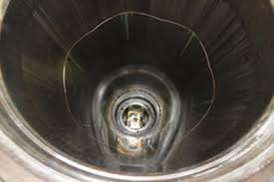
Fill in the gaps with the following words: bore/severe/ extend/welding/ vary/ abrasive/ gauged/ wear/ operating
Cylinder liners will 1………………….in service. Correct operation of the engine (not overloading, maintaining correct 2………………………. temperatures) and using the correct grade and quantity of cylinder oil will all help to …………………. the life of a cylinder liner. Wear rates 4…………………, but as a general rule, for a large 5……………… engine a wear rate of 0.05mm/1000 hours is acceptable. The liner should be replaced as the wear approaches 0.8 - 1% of liner diameter. The liner is 6………………… at regular intervals to ascertain the wear rate.
As well as corrosive attack, wear is caused by 7………………………….. particles in the cylinder (from bad filtration/purification of fuel or from particles in the air), and scuffing (also known as adhesive wear). Scuffing is due to a breakdown in lubrication which results in localised 8………………. between points on the rings and liner surface with subsequent tearing of micro- scopic particles. This is a very 9…………………….. form
of wear.
Page 356

Slide 5
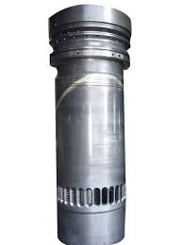
Fill in the correct form of the word in capital letters:
On some large bore, long stroke engines it was found that undercooling 1……………….FAR down the liner was taking place. Why is this a problem? The hydrogen in the fuel combines with the oxygen and burns to form water. 2……………………..NORMAL this is in the form of steam, but if it is cooled it will condense on the liner surface and wash away the lube oil film. Fuels also contain sulphur, which burns in the oxygen and the products combine with the water to form 3……………………..SULPHUR acid. If this condenses on the liner surface, then 4……………………CORRODE can take place. Once the oil film has been destroyed then wear will take place at an 5………………………….ALARM rate. One solution is to insulate the outside of the liner so that there is a 6……………………………….REDUCE in the cooling effect. On the latest engines, the liner is only cooled by water at the very top, relying on the air in the scavenge space to cool the lower part of the liner.
Page 356

Slide 6
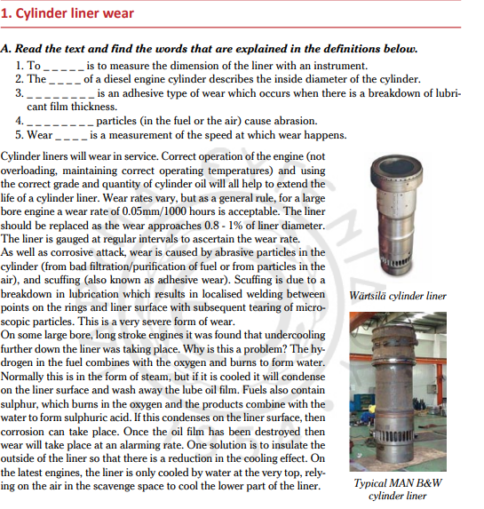
Vocabulary: gauge, dimension, bore, scuffing, occur, thickness, abrasive, rate, wear, extend, acceptable, corrode, interval, approach, ascertain, purification, welding, subsequent, tear, severe, condense, take place, insulate, reduce, rely, scavenge

Slide 7
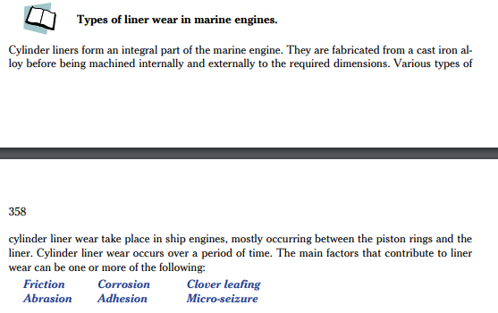

Slide 8
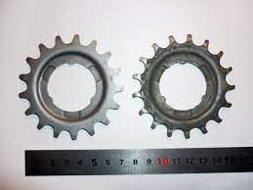
Find the synonym word. The first letter is given
Frictional wear takes place between the 1. s _ _ _ _ _ _ _ (gliding) surfaces, between the cylinder liner and piston rings, and can somewhat be controlled by 2. a _ _ _ _ _ _ _ (enough) cylinder lubrication, but is also affected by:
Materials of 3.c _ _ _ _ _ _ _ _ _ _(building) Choice of cylinder lubrication Engine load Surface finish Piston speed
Other factors that can either increase or reduce the rate of wear the cylinder 4. i_ _ _ _ _ _ (comprise) working pressure, temperature, and maintenance of piston rings, combustion efficiency, and any 5. con_ _ _ _ _ _ _ _ _ _ (pollution) from air or fuel.

Slide 9
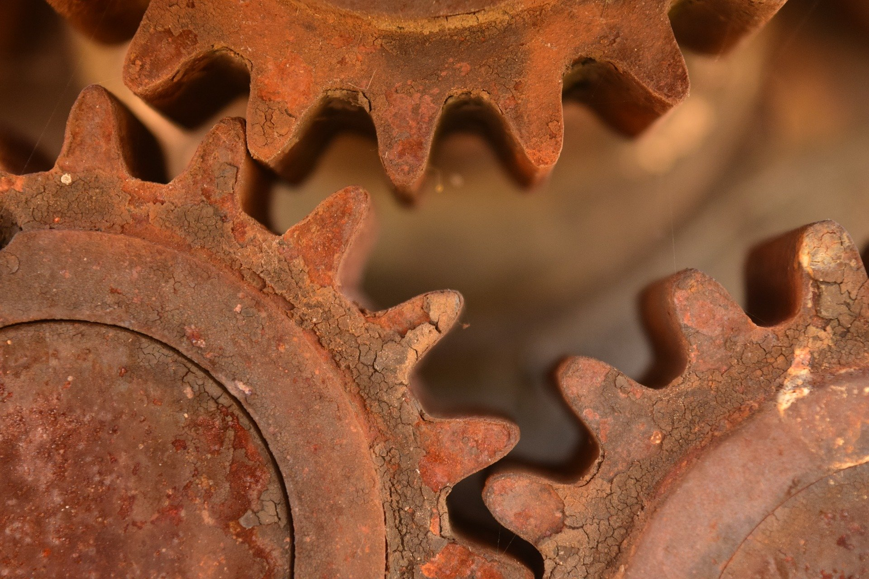
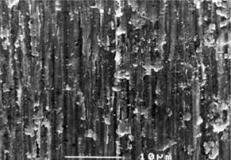
Choose the correct answers:
Corrosion
Corrosion occurs mainly in engines burning 1. MDO/heavy fuels, particularly those with a high sulphur content. It is caused by the acid formed during combustion, and this may be neutralized by the use of high alkaline 2. cylinder/ circulating oil. Sulphuric acid corrosion may be caused in the 3. higher/ lower part of the liner if the jacket cooling water temperature is too low. This may allow vapors present after combustion to 4. condense/ expand. The moisture formed absorbs any sulphur present to form sulphuric acid. This can be prevented by maintaining jacket temperature 5. below/ above the corresponding dew point. Water vapor will be present from the combustion of hydrogen together with any water present in the fuel. It may be increased if water passes from the charged air cooler.
Abrasion
Abrasion is caused from 6. metal/ soft particles, both from the splintering of piston rings and fuel oil, ash being present in some heavy fuels, along with catalytic fines that will act as an abrasive. These hard particles act as an abrasive material between the piston 7. pins/ rings and the cylinder liner causing liner abrasive wear.

Slide 10
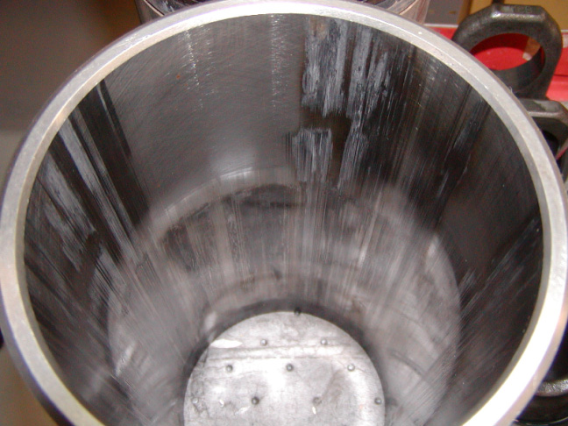
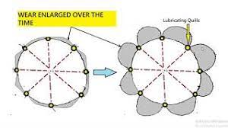
Find the synonyms of the following words in the text. The synonym words are in bold letters:
to have moving parts bind and stop moving as a result of excessive pressure, temperature, or friction- made worse- not enough- delivery- engraving, scratching- damaging- occur- too much- tend to- situated around, in the direction of, on, or along an axis
Adhesion
Adhesion or scuffing is a form of local welding between particles of the piston
rings and liner rubbing surface, resulting in a rapid wear. This is 1. exacerbated
if the lubrication oil film between piston rings and liner is reduced due to
2. excessive temperature, 3. insufficient supply or incorrect 4. distribution of
oil, and piston blow-by. Engines operating on some low sulphur grades of fuel oil
may also 5. be prone to scuffing damage.
Clover Leafing
This is a form of wear on cylinder liners due to high sulphur content in the fuel
oil. Clover leafing 6. takes place between each pair of lubricating quills.
Cylinder oil is injected with maximum alkalinity from the quills and as it passes
down, the alkalinity reduces and acidity increases. This results in acidic
7. etching on the liner surface in the form of leaf scales along the sides of lubricating quills.
Micro-seizure
Appearance: micro seizure marks run 8. axially on the liner surface. Causes: this is due to irregularities in the liner and piston rings coming into contact during operation. They occur as a result of breakdown of lubrication due to an insufficient quantity of lube oil, insufficient viscosity, or excessive loading. Effects: this results in instantaneous 9.seizure and tearing takes place on the liner surface and on the piston rings surface. Micro-seizure may not be 10. destructive; indeed it often occurs during a running in period. However, it does become destructive if it is allowed to continue.

Slide 11
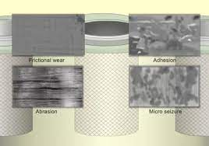

Slide 12
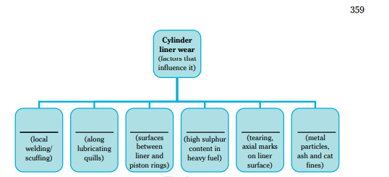
Scan the text and fill in the diagram below, using the words highlighted in the text in blue. The diagram outlines the text, giving titles for each type of wear and some key words that either describe or give causes for the types of wear.
Blow-by: during normal operation, a small amount of unburned fuel and exhaust gases escape around the piston rings and enter the crankcase, referred to as “blow-by”.

Slide 13
Fill in the gaps with the following definitions: clover leafing, corrosion, fretting wear, microseizure, ship corrosion, abrasion, adhesion
3……………………………..is a type of wear that occurs as a result of repeated cyclical rubbing between the surfaces of two different objects. When solid or liquid particles of one object impinge against the surface of another object, the resulting wear is known as erosive wear.
4…………………………is caused when the liner and piston ring material is pressed together
causing localised welding of the material in the absence of sufficient lube oil. The
causes are insufficient oil and/or excessive cylinder pressures causes heavy ring/liner
contact forces. The appearance is heavy scratching/tearing in the vertical direction,
together with a localised hardening of the ring and liner material
1……………………is corrosion due to sulfur will be high due to the presence of water in fuel and condensate in the air. This wear is generally seen between the quills. The wear near the quills enlarges and gives a characteristic of the clover leaf shape to the wear pattern. It will be caused when the supply of lube oil is not uniform around the radial bore of the liner.
2………………………………is a major hazard for the industry. The deterioration of these structures causes higher maintenance costs, early system failures, or an overall shortened service life. Corrosion is a natural process which as a result, reduces metallic elements back to their original state.
5…………………………………..is the action or process of adhering to a surface or object.
6…………………………..is the process of scraping or wearing something away.

Slide 14
Clover Leafing is corrosion due to sulfur will be high due to the presence of water in fuel and condensate in the air. This wear is generally seen between the quills. The wear near the quills enlarges and gives a characteristic of the clover leaf shape to the wear pattern. It will be caused when the supply of lube oil is not uniform around the radial bore of the liner. The normal effect is for the oil to reduce in alkalinity away from the injection point, thus if the oil becomes acidic then high corrosive wear rates
will result. This will cause uneven bore wear rates, with heavy wear in the areas
furthest away from the oil injection points.
Microseizure is caused when the liner and piston ring material is pressed together
causing localised welding of the material in the absence of sufficient lube oil. The
causes are insufficient oil and/or excessive cylinder pressures causes heavy ring/liner
contact forces. The appearance is heavy scratching/tearing in the vertical direction,
together with a localised hardening of the ring and liner material.
Ship corrosion is a major hazard for the industry. The deterioration of these structures causes higher maintenance costs, early system failures, or an overall shortened service life. Corrosion is a natural process which as a result, reduces metallic elements back to their original state.
Fretting wear is a type of wear that occurs as a result of repeated cyclical rubbing between the surfaces of two different objects. When solid or liquid particles of one object impinge against the surface of another object, the resulting wear is known as erosive wear.
Adhesion is the action or process of adhering to a surface or object.
Abrasion is the process of scraping or wearing something away.

Slide 15
Read the text and fill in the missing words. The first letter is given. P.359
Reasons for Cylinder Liner Wear (and ways to measure it)
The wear in the cylinder liner is mainly because of the following reasons:
1) Due to f …………………………….
2) Due to c ………………………………
Abrasion
Scuffing or Adhesion
Whenever two surfaces slide over each other, friction is produced which leads to wearing down of both the surfaces. In cylinder liner wear the surfaces of piston 3) r……………. are sliding over the cylinder liner. The frictional wear depends upon various 4) f………………. like speed of movement between the surfaces, material involved, temperature, 5)l…………………… on engine, pressure, maintenance, lubrication, and combustion efficiency.
The wear due to corrosion is caused due to the 6)b………….. of heavy fuel oil in the combustion space. This happens because heavy fuel oil contains high sulphur content. During 7)c………………………… , acids are formed inside the space which should be neutralized by cylinder oil which is alkaline in nature. The production of acids will be more if sulphur content is more, leading to the formation of sulphuric acid. Sulphuric acid is formed due to absorption of the condensate or moisture present inside the combustion space. Sulphuric acid corrosion is found more in the lower part of the liner as the temperature of jacket water is very 8)l……………. .

Slide 16
Corrosion due to sulphur will be high due to the presence of water in fuel and condensate in the 9) a……………….. This wear is generally seen between the quills. The wear near the quills enlarges and gives a characteristic of the clover leaf shape to the wear pattern. This phenomenon is called clover leafing. Abrasion is a wear due to the 10)h……………… particles present and formed during combustion. Catalytic 11)f…………….. in the fuel and the ash formed during the combustion causes abrasive wear.
Adhesion or Scuffing is a form of local welding between the particles of piston rings and the liner surface. As the piston is moving 12)i…………………………. the liner, the welding which has occurred breaks and leads to the formation of abrasive material. The abrasive material will increase the 13)r…………… of wear of the liner. This is generally caused by insufficient lubrication due to which large amount of heat is produced and microscopic welding of rings and liner surface takes 16)p…………………….. Due to this type of wear the liner loses its properties to adhere cylinder oil to the surface. One more reason for this phenomenon is polishing of the surface caused by scuffing, giving liners a mirror finish.
Scuffing of cylinder liner

Slide 17
D. You will read a text on gauging the cylinder liner and minimizing its wear. Six phrases have been extracted from the text. Fill in the missing phrases in the appropriate space. Write the correct number in each box. Page 360
� per 1000 running hours � from the charge air � as per
� for both port starboard and forward aft positions � at regular intervals � or vice versa
How can cylinder liner wear be minimized?
Cylinder wear can be minimized by carrying out the following steps:
1) By avoiding any ingress of water inside the liner by properly treating the fuel oil.
2) By maintaining the correct feed rate and grade of cylinder oil.
3) By avoiding ingress of moisture …[1]...
4) By maintaining proper jacket water temperature.
How is cylinder liner wear gauged?
Cylinder liner has to be gauged …[2]… as specified in the maintenance manual. The records of gauging are kept for each cylinder and wear rate is calculated. The liner has to be cleaned and inspected before the gauging. Generally while taking the measurement, the temperature of the liner and micrometer should be the same. If the temperature exceeds that of the liner …[3]… then the reading has to be corrected by multiplying the value with the correction factor and deducting the value obtained from the reading taken. The reading obtained at the end will be the correct reading.
The cylinder liner wear is measured by a standard template, which consists of strategically positioned holes, wherein the micrometer is placed and the readings are taken. The readings are taken …[4]... This is done because the wear is not the same in both directions and the ovality is checked.
The wear rate will be different in the liner. The wear will be more in the top one third part as combustion takes place there and temperatures and pressure are also very high at the top.
An approximate normal wear rate of the liner is about 0.1 mm …[5]... The wear rate increases if the engine is overloaded. Generally the liner has to be replaced when the wear is about 0.6-0.8% of the bore diameter or …[6]… the manufacturer’s recommendation.

Slide 18
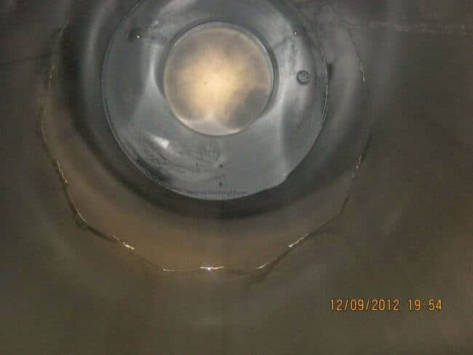
What is cold corrosion?
Fill in the gaps with the correct form of the word in capital letters.
Cold corrosion is when 1……………….. SULPHUR acid forms on the liner walls in an engine cylinder and corrodes the liner surface. This 2………………………NORMAL corrosion then creates 3……………………EXCESS wear of the liner material. This has become an issue 4……………………….RECENT in new engines which are now designed to comply with the Tier II NOx regulations and Energy Efficiency Design Index (EEDI) guidelines. To meet the new regulations, engine cylinders must operate under increased pressures and reduced 5……………………….OPERATE temperatures. This creates conditions below the dew point that allows water to 6………………………CONDENSATE on the cylinder liner walls. This then combines with sulphur from the combustion process to form sulphuric acid, which leads to cylinder liner wear or cold corrosion.
How serious is cold corrosion for my engine?
Cold corrosion is at its most serious in the 7………………..LATE engine designs. It also impacts earlier engine designs modified for part-load or low-load operation
(known as ‘slow steaming’, where vessels may operate as low as 10% load).
These 8…………………………….MODIFY may
include; turbocharger cut-out, 9……………………….VARY turbo charger
nozzle rings fitted, exhaust gas by-pass valve fitted, and engine tuning changes.
Some modified engines become mildly
10…………………….CORRODE whereas others may be more seriously affected.

Slide 19
How do I manage cold corrosion?
Fill in the gaps with the following words: identify/ implementing/ tackle/optimized/ selected/ avoid/ crucial
Whilst it is very difficult to 1………………. cold corrosion, there are a number of steps you can take which can help to 2…………….. the issue:
 3………………. how serious the problem is through onboard oil analysis – MAN recommends the use of a ‘Sweep Test’ and Wartsila have a similar ‘Quick Test’.
 4……………………… a condition monitoring programme to monitor the performance of the engine and cylinder oil is 5…………………. This programme should monitor the parameters of iron wear and the residual Total Base Number (TBN) in scrape down oil.
– It will enable the correct cylinder oil to be 6………………….
– It will enable the feed rate to be 7……………………. to suit the engine, operating conditions and the cylinder oil in use.

Slide 20
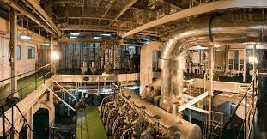
Diesel Engine Troubleshooting
A. You will read a list of possible starting difficulties, some causes and their remedies. What do the words in bold italics in the list mean? Match them to the explanation. Write the correct letter (a-g) in the boxes.
� 1. defective
� 2. solenoid valve
� 3. puncture valve
� 4. faltering
� 5. sluggishness
� 6. alternatively
� 7. respectively
a) slow motion, idleness
b) faulty
c) irregular running of the engine
d) as a second choice
e) electromagnetic valve
f) correspondingly, to the relevant one
g) injection valve

Slide 21
Match the problem with the remedy
Difficulty | Point | Possible Cause | Remedy
Engine fails to turn on starting air after START order has been given | 1 | Pressure in starting air receiver too low. | Lift locking plate to working position.
 | 2 | Valve on starting air receiver closed. | Open the valve.
 | 3 | Valve to starting air distributor closed. | Start the compressors. Check that they are working properly.
 | 4 | No pressure in the control air system. | Check the pressure (normally 7 bar). If too low, change over to the other reducing valve and clean the filter.
 | 5 | Main starting valve (ball valve) locked in closed position. | Open the valve

Slide 22
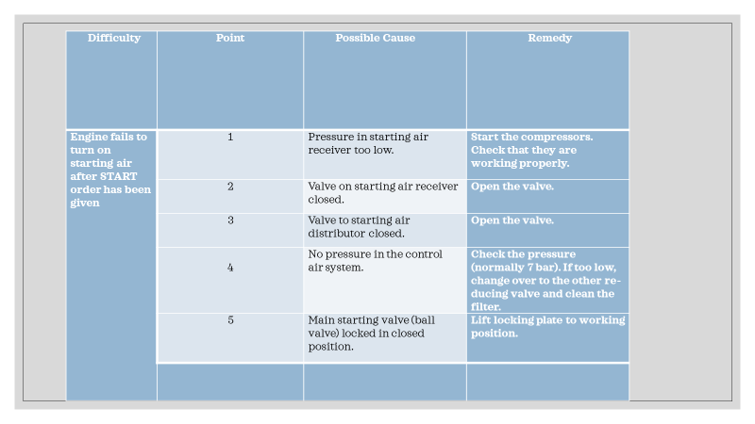
answers

Slide 23
6 | Main starting valve (ball valve) does not function owing to acti- vated turning gear locking device. | Overhaul the control valve slide.
7 | Control selectors are wrongly set. | Release the turning gear lock device.
8 | The starting air distributor has not activated its end stop valve. | Lubricate and make the pistons movable. Overhaul the starting air distributor.
9 | Pistons in starting air distributor sticking. | Check the timing marks. Alterna- tively, with engine piston 1 in TDC, check that the starting air distributor piston for cyl. 1 is lifted to the same height (with a tolerance of about 0.2 mm) by, respectively, the AHEAD and ASTERN cam of the starting air distributor.
10 | Distributor wrongly adjusted. | Lubricate and make the shaft movable so that the distributor moves easily. Check and adjust the air cylinder and end stop valves.
11 | Sticking control valve for starting air distributor. | Correct the setting.

Slide 24
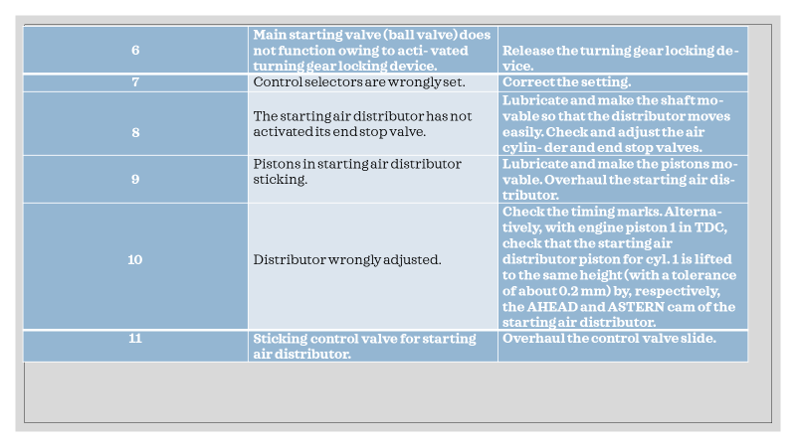

Slide 25
Difficulty | Point | Possible Cause | Remedy
Engine does not reverse when order is given | 12 | Starting air valves in cylinder co- vers defective. | Find where the signal has been stopped and correct the fault.
 | 13A | Control air signal for staring does not reach the engine. | Set the slow turning adjustment screw so that the engine turns as slowly as possible without faltering.
 | 13B | Propeller blades are not on zero- pitch (CPP-plants). | Set pitch to zero position.
 | 14 | Coil of solenoid valve for the desired direction or rotation does not reach the engine. | By loosening one copper pipe at a time on the signal’s route through the system, find the defective valve or pipe which stops the signal. Repair or repair the valve
 | 15 | Control air signal for the desired direction of rotation does not reach the engine. | Pressure test the valves. Replace or overhaul defective ones.
 | 16 | ‘Slow-turning’ (option) of engine adjusted too low. | See the “Bridge Control” instruction book.

Slide 26
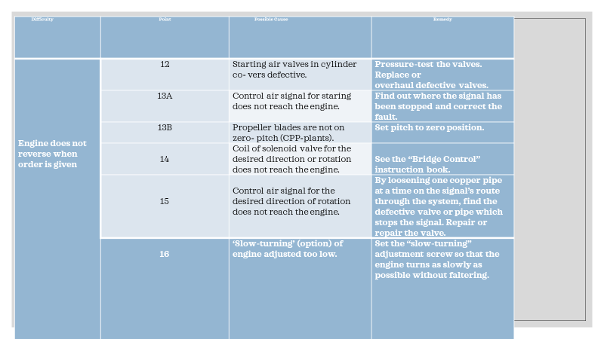

Slide 27
17 | ‘Slow-turning’ (option) is not cancelled (automatic control). | Pressure-test the valves for leaka- ges. Replace or overhaul the defec- tive valves.
18 | Faulty timing of starting air distributor. | Check the timing, see also point 10.
19 | Defective starting valves in cylin- der covers. | See the “Bridge Control” instructions

Slide 28
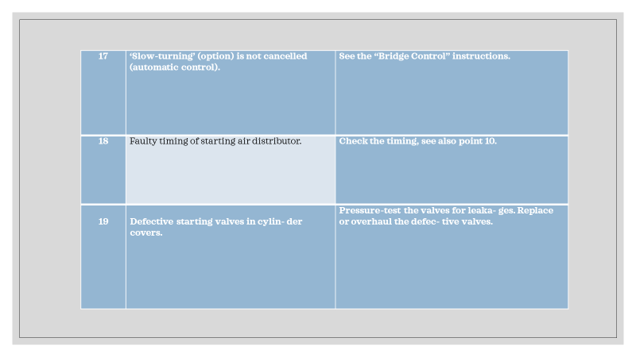

Slide 29
Engine turns on starting air but stops after receiv- ing order to run on fuel
 | 20 | Puncture valves not deaerated. | Automatic running: Adjust the starting level. Manual running: shorten the starting air period.
 | 21 | Shut-down of engine. | See the Governor instructions.
 | 22 | Sluggishness in the manoeuv- ring gear. | Check pressure and temperature. Reset “shut down”.
 | 23 | Faulty adjustment of manoeuv- ring gear. | The pressure shall be set between 1.6 and 2.0 bar, and maintained for about 6 seconds.
 | 24 | Governor air booster (Woodward) does not supply oil pressure to the governor during the starting air pe- riod (Woodward governor only). | Find the cause of the stop-order and correct the fault.
 | 25 | The pre-set speed setting pressure to the governor (Woodward), is set too low, or for too short a period. | Check the rod connections. Check that the fuel pump index corresponds to “Adjustment on testbed”.
 | 26 | Engine runs too long on starting air, so the governor has time to regulate the pump index down- wards, before running starts on fuel oil. | Lubricate the manoeuvring gear. En- sure that the fuel pumps, rod connec- tions and bearings are movable.

Slide 30
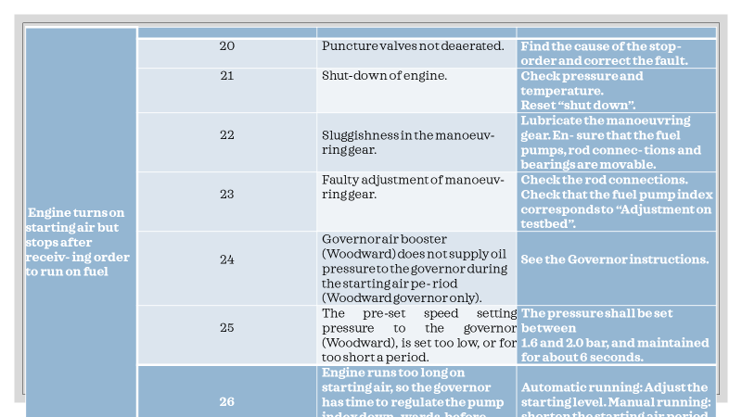

Slide 31
Difficulty | Point | Possible Cause | Remedy
Engine turns on fuel, but runs une- venly (unstable) and will not pick up rpm | 27 | Fault in governor. | Start auxiliary blowers.
 | 28 | Auxiliary blowers not functioning. | Increase the pressure.
 | 29 | Scavenge air limit set at too high or too low level. | Check level of scavenge air pressure and the exhaust gas pressure at the actual load. Compare the pressures with shop or sea trial observations.
 | 30 | Fuel filter blocked. | Clean the filter.
 | 31 | Too low fuel pressure. | Check suction valve and puncture valve in fuel pump. Check individual index, if no index, check the rod connections and the safety shut down system. If fault not found, change fuel valves.
 | 32 | One or more cylinders not firing. | Woodward governor Check that the governor functions with the correct oil pressure. Check that the limiting functions in the governor are adjusted correctly. Deflection at the starting moment shall be about 6 on the terminal lever scale. Electronic governor See the Governor instruction book.

Slide 32
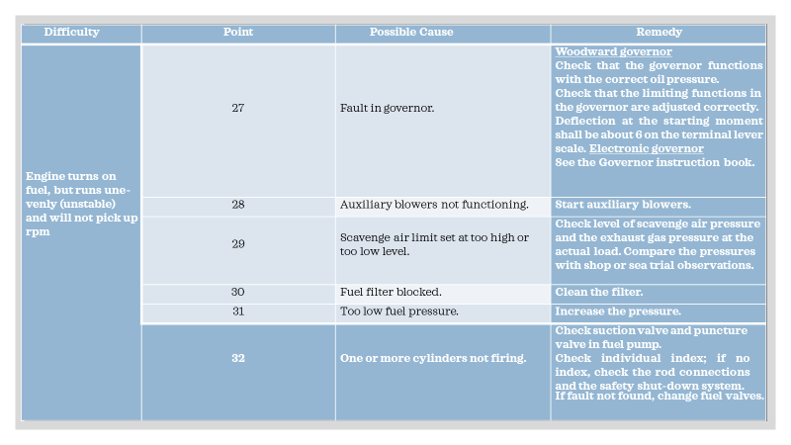

Slide 33
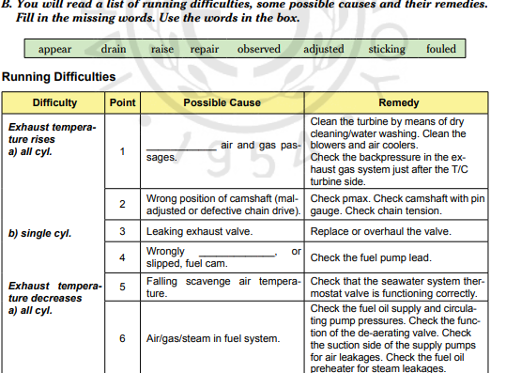
p.364

Slide 34
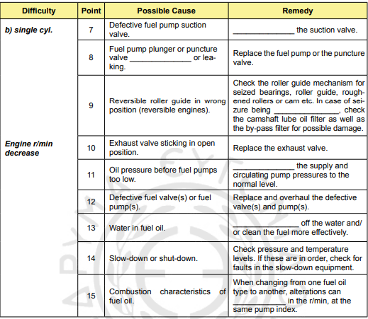

Slide 35
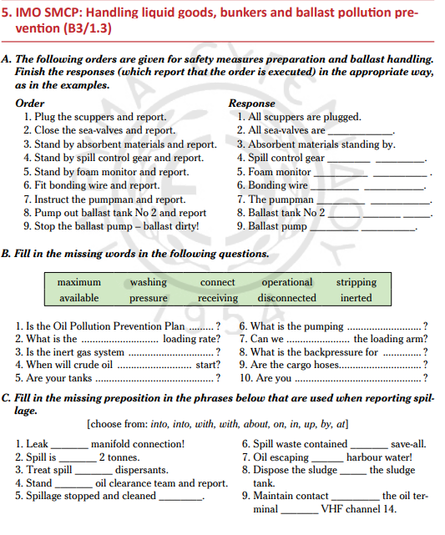
p.370

Slide 36
D. Fill in the correct verb. Slop/ start/ order/ inform/ pump/ keep/ increase
1. …………………. the slops into the slop tank.
2. …………………. a shore slop barge.
3. ………………… the ballast overflow pump.
4. …………………. pumping rate.
5. ……………….. pollution control!
6. ………………… a safe working pres- sure.
7. ……………….. pumping slowly.

Slide 37
What are reefer ships?
What is the purpose of the refrigeration plant?
Refrigeration p. 365 What do the words in bold mean? Choose the correct answer:
The refrigeration plants on merchant vessels play a vital (important, severe) part in carrying refrigerated cargo and provisions for the crew on board. In reefer ships, the temperature of the perishable (fresh, decaying) or temperature sensitive cargo, such as chemicals or liquefied gas, is controlled by the refrigeration plant of the ship. The same plant or a smaller unit can be used for maintaining the temperature of different provision rooms carrying food stuffs for crew members. The main purpose (reason, cause) of ship’s refrigeration plant is to avoid any damage to the cargo or perishable material so that the cargo is transported in good condition. Refrigeration prevents growth (development, determination) of micro-organisms, oxidation of cargo etc.

Slide 38
Fill in the gaps with the following words to complete the text about the main components of the refrigeration unit: circuits/ commonly/ regulates/ main/ moisture/ solenoid/ supplied/ consists
Any refrigeration unit works with different components in line to each other in series. The a. ……………. components are:
1. A reciprocating single or two stage compressor is b. …………………….. used for compressing and sup- plying the refrigerant to the system.
The condenser is used to cool down the refrigerant in the system.
The cooled refrigerant is c. …………………. to the receiver, which is also used to drain out the refrigerant from the system for maintenance purposes.
The drier connected in the system d. …………………. of silica gel to remove any e. …………………. from the refrigerant.
Different f. …………………………valves are used to control the flow of refrigerant into the hold or room.
An expansion valve g. ……………….. the refrigerants to maintain the correct hold or room temperature.
The evaporator unit acts as a heat exchanger to cool down the hold or room area by transferring heat to the refrigerant.
The control unit consists of different safety and operating h. …………………. for safe operation of the reefer plant.

Slide 39
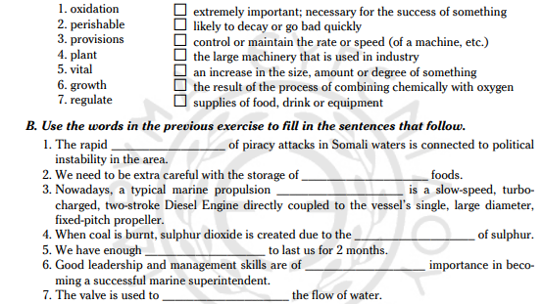
Match the words to their definitions

Slide 40
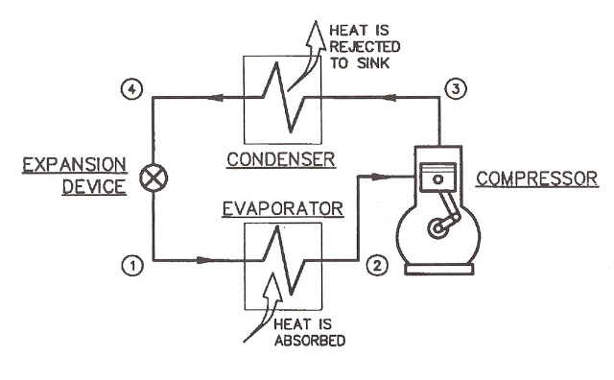
The following text comes from a company advertisement of refrigeration systems. What are the parts of the refrigeration cycle?
Fill in the gaps with the missing word. P. 366
Marine refrigeration system
A marine refrigeration system is a key element onboard any vessel.
Well-maintained food and drinks 1………….. essential for passengers’
and crew’s health. And obviously, cargo ships need to 2……….
equipped 3…………….high quality marine refrigeration and air
conditioning, 4………….. their core business is to assure the quality
of the cargo during transport.
How a refrigeration system works
The refrigeration cycle consists 5……….. the following components: the refrigerant (R22 is an often used refrigerant, but 6………….. to the European F-gas Regulation, we have 7…………….. researching alternatives like R290, Propane), the compressor (we use Turbocor compressors in our systems as these are exceptionally sustainable, totally oil-free and take 8………….. half the space of conventional compressors), the condenser (our condensing units are 9………………… sea-water cooled, fresh-water cooled or air-cooled), the evaporator and the expansion device.

Slide 41
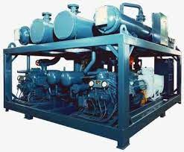
Fill in the missing verbs in the description of the system operation: returned, absorbs, compressed, starts, turns into, cools
The refrigerant starts as a gas and is (1) ………………… in the compressor, which increases its temperature dramatically. Thereafter, the condenser (2) …………………the hot high pressure refrigerant and this way the refrigerant (3) ……………………….. a liquid. Next, the evapora- tor boils the refrigerant back to a gas, at a very low temperature. The change from liquid to gas (4)
……………………. the heat from the evaporator, which in turn removes the heat from the insulated refrigeration box, thereby lowering its temperature. Hereafter, the refrigerant is (5)………………………. back to the compressor and the refrigeration cycle (6) …………………………….. again.

Slide 42
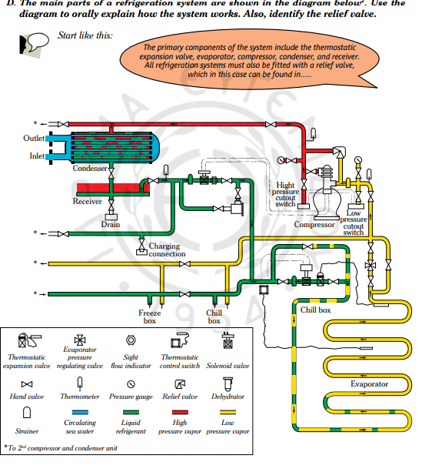

Slide 43
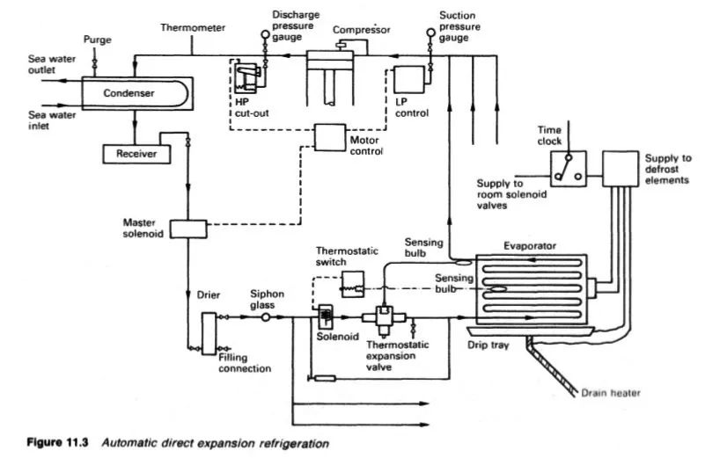

Slide 44
Main Components of Refrigeration plants
Any refrigeration unit works with different components inline to each other in series. The main components are:
1. Compressor: Reciprocating single or two stage compressor is commonly used for compressing and supplying the refrigerant to the system.
2. Condenser: Shell and tube type condenser is used to cool down the refrigerant in the system.
3. Receiver: The cooled refrigerant is supplied to the receiver, which is also used to drain out the refrigerant from the system for maintenance purpose.
4. Drier: The drier connected in the system consists of silica gel to remove any moisture from the refrigerant
5. Solenoids: Different solenoid valves are used to control the flow of refrigerant into the hold or room. Master solenoid is provided in the main line and other solenoid is present in all individual cargo hold or rooms.
6. Expansion valve: An Expansion valve regulates the refrigerants to maintain the correct hold or room temperature.
7. Evaporator unit: The evaporator unit act as a heat exchanger to cool down the hold or room area by transferring heat to the refrigerant.
8. Control unit: The control unit consist of different safety and operating circuits for safe operation of the refer plant.

Slide 45
Working of Ship’s Refrigeration Plant
The compressor acting as a circulation pump for refrigerant has two safety cut-outs- Low pressure (LP) and High Pressure (HP) cut outs. When the pressure on the suction side drops below the set valve, the control unit stops the compressor and when the pressure on the discharge side shoots up, the compressor trips.
LP or low pressure cut out is controlled automatically i.e. when the suction pressure drops, the compressor stops and when the suction pressure rises again, the control system starts the compressor. HP or high pressure cut out is provided with manual re-set.
The hot compressed liquid is passed to a receiver through a condenser to cool it down. The receiver can be used to collect the refrigerant when any major repair work has to be performed.
The master solenoid is fitted after the receiver, which is controlled by the control unit. In case of sudden stoppage of compressor, the master solenoid also closes, avoiding the flooding of evaporator with refrigerant liquid.
The room or hold solenoid and thermostatic valve regulate the flow of the refrigerant in to the room to maintain the temperature of the room. For this, the expansion valve is controlled by a diaphragm movement due to the pressure variation which is operated by the bulb sensor filled with expandable fluid fitted at the evaporator outlet.
The thermostatic expansion valve supplies the correct amount of refrigerants to evaporators where the refrigerants takes up the heat from the room and boils off into vapours resulting in temperature drop for that room.
This is how temperature is maintained in the refrigeration plant of the ship.
What are the Safety Devices on the Refrigeration System of a Ship?

Slide 46
What are the Safety Devices on the Refrigeration System of a Ship?
A reefer system is the back bone of ships carrying refrigerated cargo. A malfunction of any of the components of the system can lead to degradation and wastage of perishable and cold storage cargo including provision for a ship. It is therefore important to maintain and run the refrigeration plant properly to avoid any breakdowns.
In this article we will learn about the safety feature of the refrigeration plant. Before that, you must read the construction and working of the ship’s refrigeration plant.
To have an efficient and hassle free operation of a ship’s refrigeration plant and its components, a good maintenance schedule and safety systems are adopted.
A safety system includes alarm, cut offs, and trips which safeguards the machinery and its parts from getting damage.
The main safeties adopted for refrigeration plants are
Low Pressure or LP cut off: This is a compressor safety which cut off the compressor in the event of pressure drop in the suction line. The pressure of the suction line is continuously sensed by the control unit and when it goes below the set value, which means the room is properly cooled, the LP cut out will auto trip the compressor. When the pressure rises, indicating there is flow of refrigerant in the line due to increase in room temperature, the LP switch will start the compressor.LP cutout
High pressure or HP cut out: As the name suggests, the high pressure cut out activates and trips the compressor when the discharge side pressure increases above the limit value. The HP cut out is not auto reset and has to be done manually. The reason behind it is to manually attend the fault which is leading to rise in pressure, else this situation can lead to overloading of compressor parts and may damage the same

Slide 47
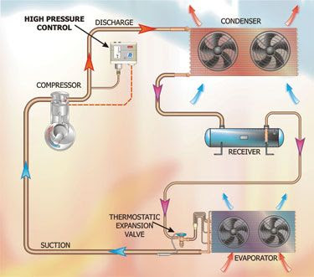
Oil differential cut out: This safety is again for compressor as it is the only machinery in the circuit having rotational parts which requires continuous lubrication. In the event of low supply or no supply of lube oil to the bearing, the differential pressure will increase and activates a trip signal to safeguard the bearing and crankshaft.
Relief valves: Relief valves are fitted in discharge side of compressor and will lift and safeguard the compressor in the event of over pressure. One relief valve is also fitted in the condenser refrigerant line to avoid damage to the condenser if there is high pressure in the discharge line.
Solenoid valves: Master solenoid valve is fitted in the common or main line after the condenser discharge. It closes when compressor stops or trips to avoid over flow of refrigerant in to evaporator. All holds or rooms are fitted with individual solenoid valve which control the flow of refrigerant to that room.
Oil heater: Oil heater is provided for the compressor crank case
oil and prevents compressor from getting excessively cold which
may effect the lubrication of the parts.

Slide 48
INSULATION
Fill in the correct form of the word in capital letters.
Insulation considerations
1………………………EXCESS heat and cold are good reasons to insulate for safety and comfort. In the marine and engine world heat problems are a condition to be identified and controlled.
Preventative Maintenance
Preventative maintenance is 2…………………..PREFER to emergency downtime for repairs. The challenge is to identify problems well before they become 3……………………CRITIC. When equipment is not operating 4………………………….CORRECT, excessive heat is generated. Non-contact infrared “Laser pointer” Thermometers can be used as a 5…………………………DIAGNOSE tool to identify such potential problems. By sweeping the thermometer over electric panels, bearings, and engines one can often identify where “hot spots” are present, and after investigation find perhaps an unknown problem developing. The correct diagnostic instruments go a long way to 6. ……………………….RESOLVE problems. This 7…………………….VALUE function for a non-contact thermometer makes it a valuable addition to your tool bag!
Heat loss from engine exhausts, piping, silencers etc., together with steam piping systems can be 8………………………..CONSIDER reduced by insulating. Due to the narrow confines of Engine Rooms, galleys and gangways on board, in the interests of safety and good working environments, insulation is critical for personnel protection, 9………………….REDUCE of ambient heat load, protection of heat sensitive sensors and equipment, fire prevention, and maximizing the 10……………………EFFECT of exhaust catalytic purifiers/filters.

Slide 49
Match the words with their definitions
outlawing |  | cure
Broad spectrum |  | Elastic
Remedy |  | 2. Coarse and stringy, like thick yarn or twine.
Adopt |  | 3. All around, extensive, global
Substitute |  | 4. Implement, use
Flexible |  | 5. Unbending
Resistant |  | 6. a covering or coating on a structure or material
Cladding |  | 7. coat (iron or steel) with a protective layer of zinc
Galvanized |  | 8. Resilient, unaffected
Fibrous |  | 9. Insulation, proofing
Rigid |  | 10. How long something will last
Life span |  | 11. Other
Lagging |  | 12. Cure, therapy

Slide 50
Fill in the gaps with the correct form of the word in capital letters:
Insulation Materials
Since the 1………………… OUTLAW of Asbestos, which was broad-spectrum temperature insulation, alternative insulation materials had to be found. Fiberglass, Mineral Wool, CalSil and Ceramic Insulation have been adopted as substitutes. All these materials are considered 2. …………………. COMBUSTIBLE by the various Insurance Authorities and Coast Guard. Fiberglass, Mineral wool and Calsil materials are rated up to 625°C and the Ceramic Insulation up to 1200°C. Fiberglass, Mineral Wool, and Ceramic Insulation are available in 3. ……………………….VARY forms, depending on the product, such as flexible blanket, and 4………………….. PREFORM pipe and elbow sections. Being 5…………………… FIBER they stand up well to high vibration conditions without breaking down. Calcium Silicate is a good insulator, comparative to glass fiber, available in pipe and elbow preforms but because of its rigid form, is not a good insulation in high vibration environments, as it tends to break up. Each type of insulation should be used where their best 6…………………….. CHARACTER are used to full advantage. There are price differences between the different types of insulation, and often a decision made on price alone could lead to a short-term solution that has to be remedied well before the normal expected life span of the material. As these insulation materials do not have a wear 7………………………… RESIST finish, they have to be covered with a 8. ………………………… PROTECT outer skin. This could be galvanized or aluminum cladding, painted lagging, PVC, coated fiberglass or other suitable non-combustible material. The choice depends on whether permanent or 9…………………………..REMOVE insulation is required and considerations such as sea-air and other chemical environments.

Slide 51
Fill in the gaps with the following phrases: fitted/ will differ/ doubles/ replaced/ installed
Insulation Categories
There are basically two groups of insulation applications, Permanent and Removable. Similar insu- lation material is used for both applications; however the outer “cladding” or skin 1…………………...
Permanent is ideal for long pipe runs but not for any application where ease of removal for maintenance and/or inspection is essential. Permanent insulation is routinely 2………………. by an outside contractor and is messy to remove [not replaceable] – it can usually only be 3………………by a contractor. Initial installation cost is usually less than removable blankets. However, replacement insulation obviously 4……………….. the cost. This type of insulation is cut and 5…………….. on site.
Fill in the gaps with the words: manifolds/ enable/ glasses/ available/ records/ convenient
B. Removable/Reusable Insulation is modular – made up in 1………………….. size panels or sections, and can be easily installed or removed by your own crew – only sufficient blankets have to be removed to 2…………………….. a particular maintenance or inspection job to be done. After service or maintenance the blanket can be replaced without special tools. Although slightly more expensive than permanent insulation, it becomes more and more economical every time you remove and replace a module. These blankets are ideal for engine 3……………………., turbochargers, expansion joints, valves of all types, flanges, and sight 4……………………….. and also any equipment that has to be repaired/serviced in remote areas where insulation contractors are not readily 5………………... Measurements are taken on site, the blankets usually made off site in a factory, and the ship’s crew can do installation. In order to be able to replace blankets that are damaged or require to be replaced, the manufacturer usually keeps complete 6………………….of each blanket on hand.

Slide 52
Turn the sentences into passive voice.
The crew can easily install Removable Insulation.
The crew have to remove only sufficient blankets.
The crew have to repair the equipment.
They can replace the blanket.
They take measurements on site.
The crew have removed the blankets.
The crew are removing the hoses.

Slide 53
Other Insulation / Protection Systems
Find the missing word. The first letter is given:
Steam Spray Shields: During the Second World War due to the high accident 1.r_ _ _ from steam burns due to burst flange 2. g_ _ _ _ _ _ , steam spray guards were introduced in combination with removable insulation covers to protect against accidental 3. b _ _ _ _ as sailors walked by. Nowadays, spray insulation can be used for thermal insulation, sound absorption and fire resistance (melting temperature up to 750°C).
Sound Attenuation The fibrous nature of some of the insulation 4. m _ _ _ _ _ _ _s used for heat insulation is also a sound absorber. You can reduce noise by using dense membranes in composite layers. It is important to specify composites that fall within the fire safety standards required.
Find synonyms in the passage for the words: state, stipulate ______________, solid _______________, a combination of _____________, coatings _____________

Slide 54
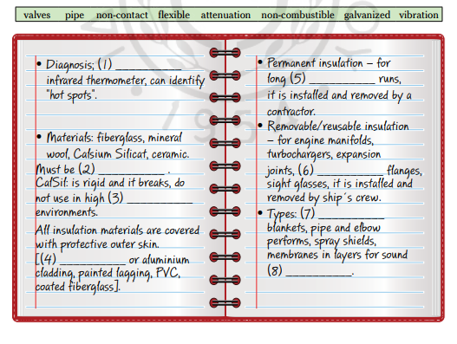
Fill in the gaps with the following words:

Slide 56
Match the words with the synonyms:
disadvantage |  | polluted
dilute |  | 2. needed
required |  | 3. Continuous
contaminated |  | 4. Show
seal |  | 5. Accuracy, correctness
precision |  | 6. Allocate, hand out
distribute |  | 7. Close, stop
indicate |  | 8. Under
beneath |  | 10. Downside
volatility |  | 11. Reasonably, adequately
constant |  | 12. Make thinner
satisfactorily |  | 13. instability

Slide 57
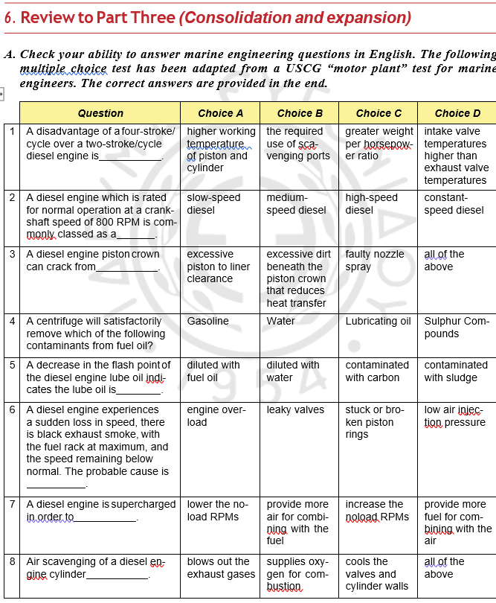

Slide 59
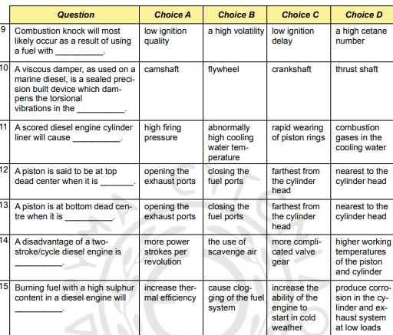

Slide 60
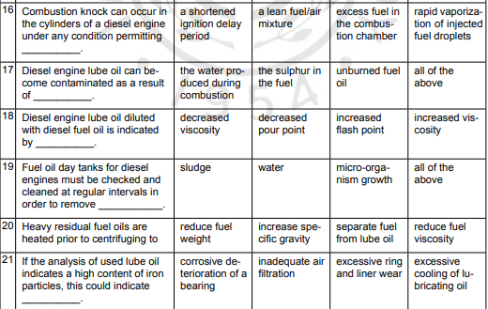

Slide 61
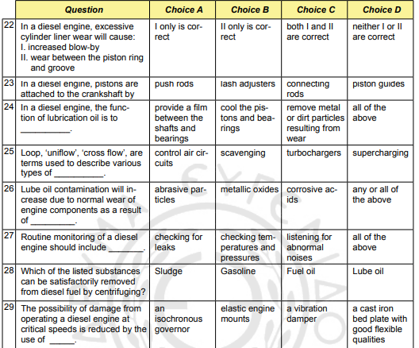

Slide 62
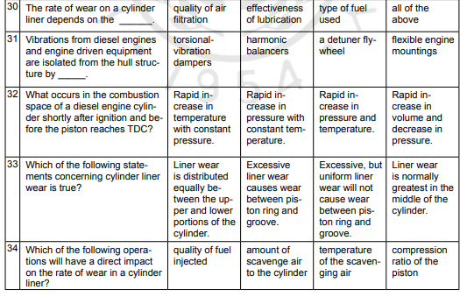

Slide 63
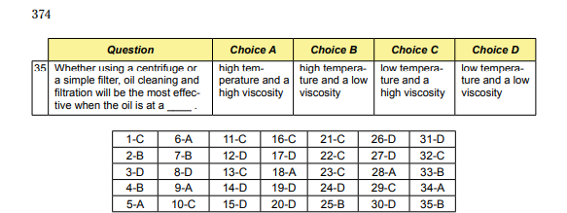

Slide 64
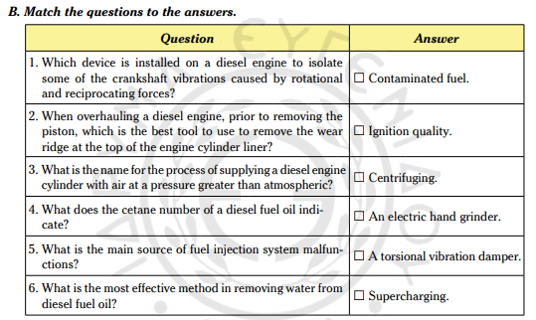

Slide 65
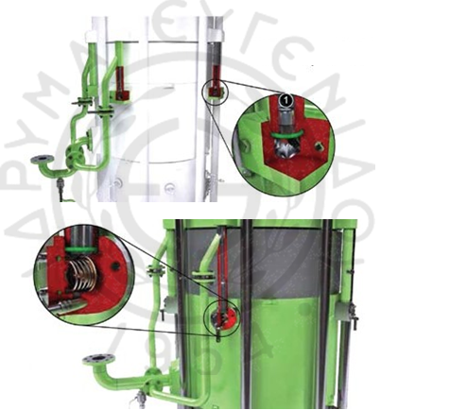
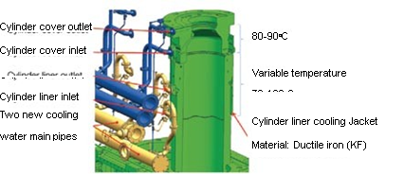
C. You will read a text on three systems developed by MAN Diesel for controlling cylinder liner corrosive wear. Which system is shown in each picture below? Circle the correct picture number for each title.
1) Internal jacket cooling water bypass controlled (JBC) system  Picture number 1 / 2 / 3
2) Load-dependent cylinder liner jacket cooling water (LDCL) system  Picture number 1 / 2 / 3
3) Jacket cooling water bypass basic (JBB) system  Picture number 1 / 2 / 3
In order to suppress cylinder liner cold corrosion, we have introduced various systems to increase the cylinder liner wall temperature. A jacket cooling water basic bypass system (JBB) can determine the correct amount of cooling water to be bypassed. The amount of bypassed water is determined by orifices mounted in the cylinder outlet pipes. Bypassing 85% of the jacket cooling water will in- crease the liner wall temperature by approximately 15oC. In addition, the jacket cooling water outlet

Slide 66
temperature is increased to 90oC. All together, an approximately 20oC increase of the liner wall temperature is achieved. Tests have revealed that bypassing an even larger amount is possible.
Furthermore, a controlled version of the JBB system, called JBC, is being developed. In this sys- tem, a thermostatic valve controls the amount of bypass in such a way that a large amount of water is bypassed at low load and less is bypassed at higher loads. The JBB and JBC systems can both be easily fitted on engines already in service. The system consists of two extra cooling water pipes along the engine. An extra pump and an extra control valve ensure up to 130°C on the cooling water for the cylinder liners while maintaining 80-90°C on the cover and exhaust valve. A high temperature on the cylinder liner is maintained up to 90% load.
The load-dependent (LDCL) system is designed with an extra mixing circuit on the engine com- prising a pump, a three-way valve and a control system. Preliminary results of service tests have shown that a significant reduction of the specific cylinder oil consumption is obtained with this four-pipe jacket cooling water system. The LDCL system does not mean changing the connections to the vessel’s cooling water system.

Slide 67
EXERCISES FOR PRACTICE –Choose the correct answer
Measuring Cylinder Liner Bore Wear
Cylinder bore is the diameter of each cylinder and it has to be gauged regularly as specified in the conservation, preservation, maintenance manual. The records of gauging should be kept for each cylinder and the wear rate, degree, amount should be calculated. The procedure that has to be followed is the following: The first step is to open the cylinder head and remove the piston after the engine has been shut down and cooled. Then, the stuffing box hole should be covered, as there may be some wreckage/ ruins/ debris falling inside the crankcase. The next step is to remove the liner spring, ring, loop in order to clean the carbon sludge, coatings, deposits from the top of the liner. For the fourth step, the liner surface should be inspected carefully, using a ladder. The cylinder liner wear is measured with a micrometer, but the analyses/ examinations/ readings should be taken both at port and starboard, forward and aft positions as the wear may differ in various directions.
Cold Corrosion
Engine cylinders, nowadays, must operate under a lot of pressure and reduced operating temperatures, to comply/ obey/ submit with Tier II NOx regulations and Energy Efficiency Design Index (EEDI) guidelines. This practice has resulted in an increase in cold corrosion. Cold corrosion is caused when water condenses on the cylinder liner walls and then the condensate, in combination with sulphur, forms sulphuric acid which can be very damaging as it undermines, deteriorates, declines the liner surface and creates excessive liner wear. When the temperature of the cooling water is raised, this type of corrosion can be kept under control. The implementation, performance, imposition of condition monitoring programs is essential as it can help to mitigate, alleviate, decline corrosion effects by selecting the correct cylinder oil and by augmenting, rectifying, optimising the feed rate that is appropriate for the engine, the operating conditions and the cylinder oil that is used.

Slide 68
Maintenance of the oil tanker piping system
Pipes used in oil tankers pose, produce, dispose a hidden danger as they go unnoticed most of the times, until they endure, bear, sustain damage which may result in flooding a space or lead to system failure. Pipes penetrate every space that is enclosed. No other system on the ship has such enormous aptitude, potential, capability to cause fire, flooding, pollution or total loss. Pipes are usually made of ferrous material that can become corroded with time, but maintenance of the piping system is not always feasible, conceivable, plausible as there are numerous pipes, most of which are inaccessible.

Slide 69
Fill in the gaps with the words: flexible, appropriate, essential, gasket, fundamental, waterproof
Sealants, adhesives, and adhesive sealants
Marine adhesives, adhesive sealants and sealants are 1………………. in shipbuilding and marine industries since they provide strong lightweight bonds to structural components and watertight sealing between surfaces. Despite the fact that they have a long history, the new improved products are not only more efficient, durable and 2…………………., but also provide improved UV and chemical resistance, as well as noise and vibration dampening.
There is a big variety of sealants, adhesives and even adhesive sealants available for marine use. When making a choice it is important to understand some 3…………………points to achieve the best results. Thus, a sealant actually does almost the same job as a washer or 4………………. It provides an airtight or watertight seal. Adhesives are glues which bind two materials together and an adhesive sealant is actually a sealant, but has adhesive qualities as well. Only marine grade sealants should be used on a boat, because they are 5……………………. and are designed especially for marine environments.
The choice of the 6……………………… sealant depends on the purpose that it is going to be used for, on how long it will last, how long is the cure time and whether you can paint over it.

Slide 70
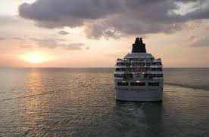
The end
Sixth semester- Elli Xenitidou

