Slide 1
A semester
PPP2 ELLI XENITIDOY

Slide 2
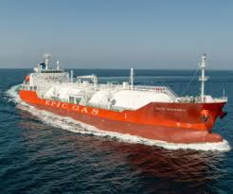
SHIPS
PARTS OF THE VESSEL
TYPES OF SHIPS

Slide 3
p.54

Slide 4
p.54

Slide 5
p.55

Slide 6
p.57

Slide 7
p.58

Slide 8
p.58

Slide 9
p.59

Slide 10
p.59,60

Slide 11
p.61

Slide 12
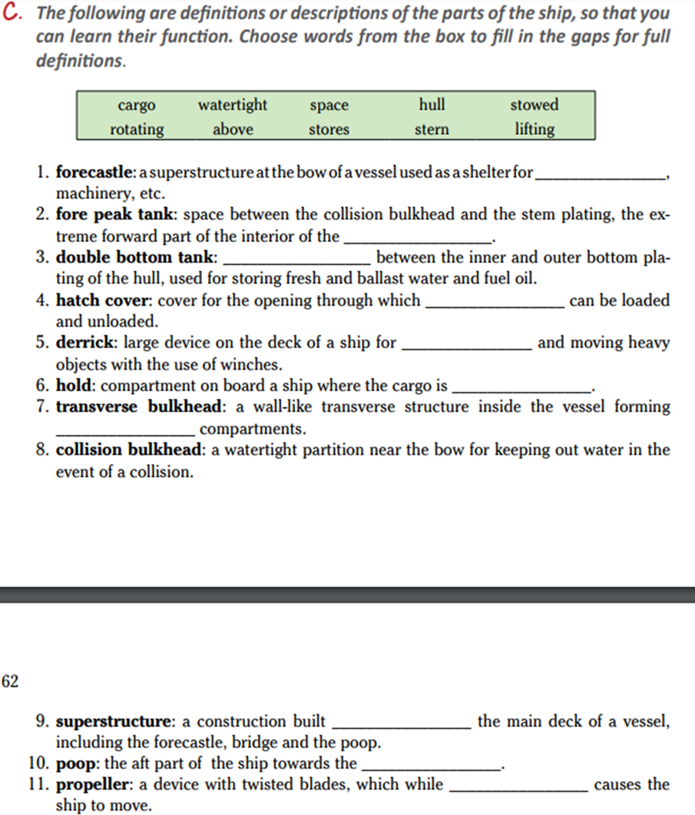
stores
hull
space
cargo
lifting
stowed
Watertight
above
stern
rotating

Slide 13
p.64

Slide 14
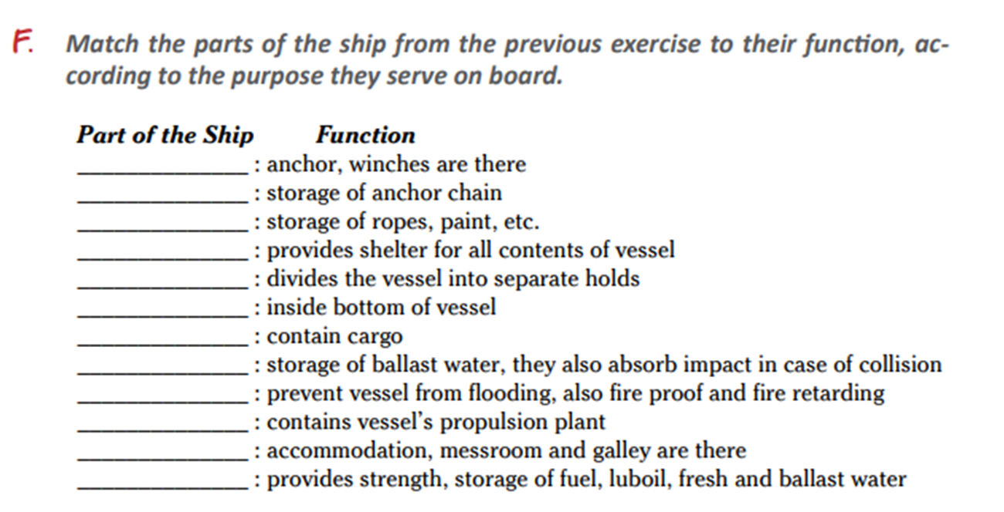
Forecastle
Chainlocker
Bosun’s stores
Deck
Bulkhead
Double bottom
Holds
Tank top
Tween deck/ collision bulkhead
Engine room
Superstructure
Fore/aft tank

Slide 15
p.64,65

Slide 16
p.65

Slide 17
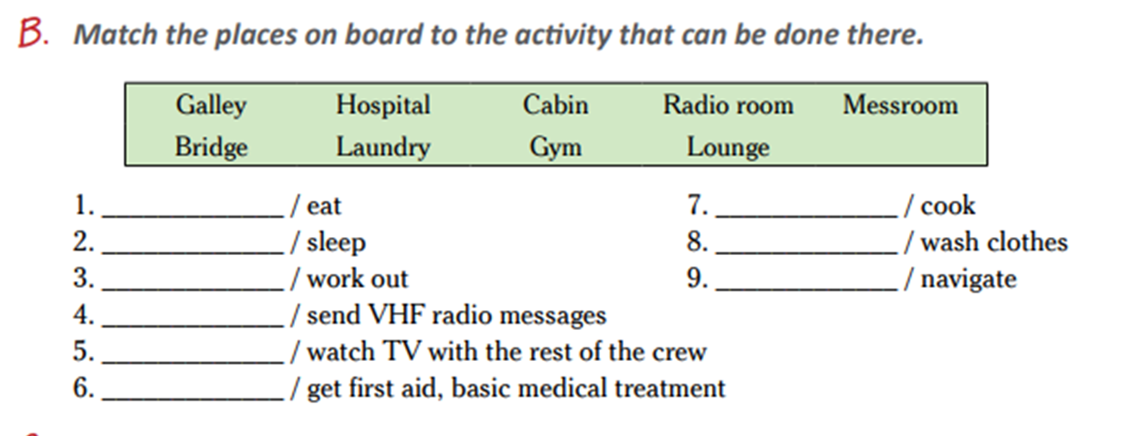
Messroom galley
Cabin laundry
Gym bridge
Radio room
Lounge
hospital

Slide 18
p.66

Slide 19
p.68

Slide 20
Π.68,69

Slide 21
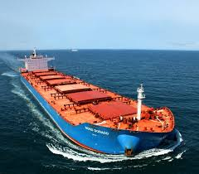
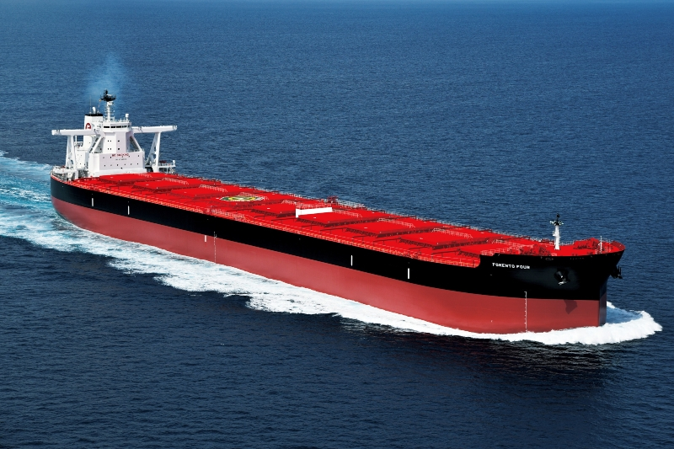
p.70 Merchant Vessels
The Bulk carrier
Today, modern commercial vessels are highly specialized, designed to carry specific types of cargo. Bulkers or Bulkies transport their cargo in bulk. They carry bulk cargo, loose cargo, either dry bulk such as coal, grain, iron ore, fertilisers, cement, sugar, light minerals or liquid bulk such as a range of chemicals including petroleum products. Dry bulk carrier have huge under- deck specialized holds, come in different sizes, can have deck cranes or simply deck hatches, have longitudinal and cross walls, called bulkheads.

Slide 22
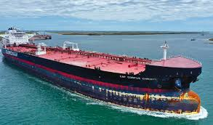
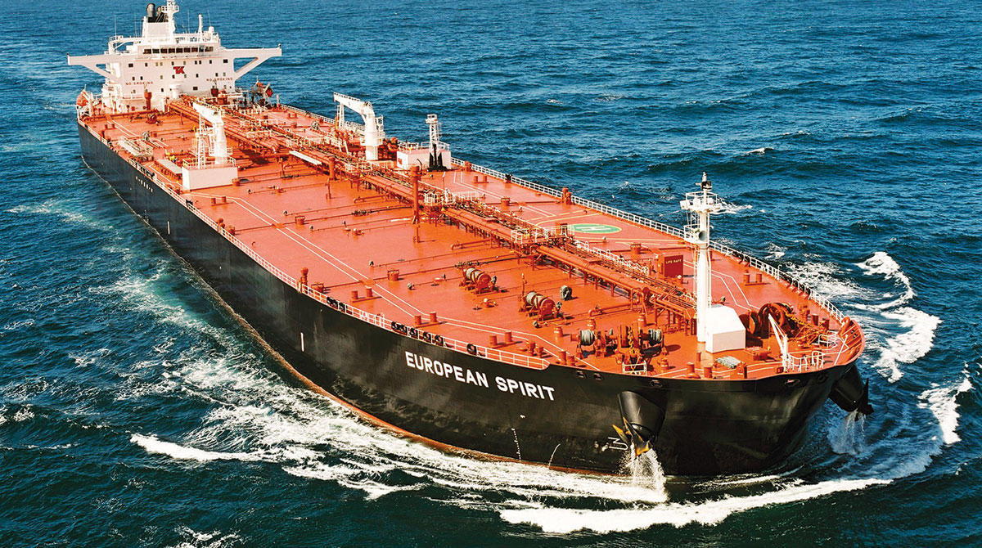
p.70,71
The tanker
The tanker is one of the most important vessels in the world’s merchant fleets today. Tankers carry liquid cargo in tanks. The best known are the oil tankers. There are two kinds- the crude carrier, which carries crude oil, and the clean- product tanker, which carries refined products such as petrol, gasoline, aviation fuel, kerosene and paraffin. Tankers range in all sizes. There are VLCC tankers, the most common types and the biggest ships afloat are the VLCC tankers. LNG carriers carry Liquefied Natural Gas at temperatures below minus 160 C. The LPG is designed to carry liquid petroleum gas at very low temperatures. Tankers have pipelines, catwalks, bulkheads, large pumps and double hulls to prevent pollution in case of collision.

Slide 23
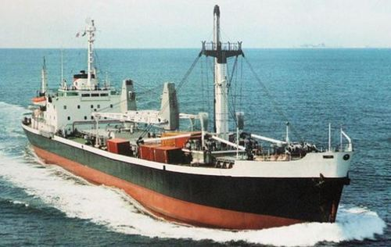
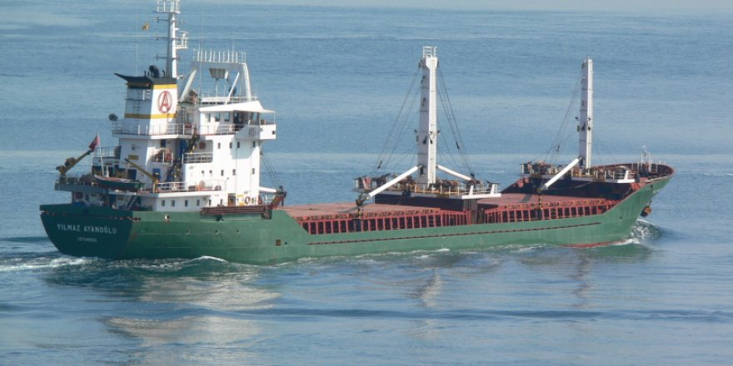
p.71
The general cargo ship
The general cargo ship or freighter is the ship in which the cargo is carried in break bulk form i.e. it is loaded into and broken out of the ship piece by piece. They transport cargo in various shapes and sizes, e.g. packaged products, heavy machinery, etc.
Size between 10 to 20000dwt and normally operate at speeds between 16 to 20 knots. They have double bottom tanks, holds, tween decks, sometimes reefer holds, cranes and heavy lifting equipment. The general cargo ships are gradually replaced by containers. They only carry cargo that is too large to fit in a container or too small to fill a whole container.

Slide 24
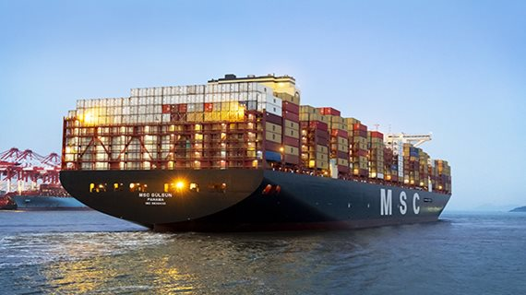
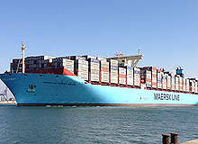
p. 70 Containers
Containers
Container vessels are designed to carry cargo placed inside containers of a uniform size, either TEU twenty foot equivalent unit or FEU forty foot equivalent unit. They can be filled with any type of cargo, they are usually stowed on the deck of the ship or inside. They can load and discharge quickly by means of large quay side cranes called gantry cranes.

Slide 25
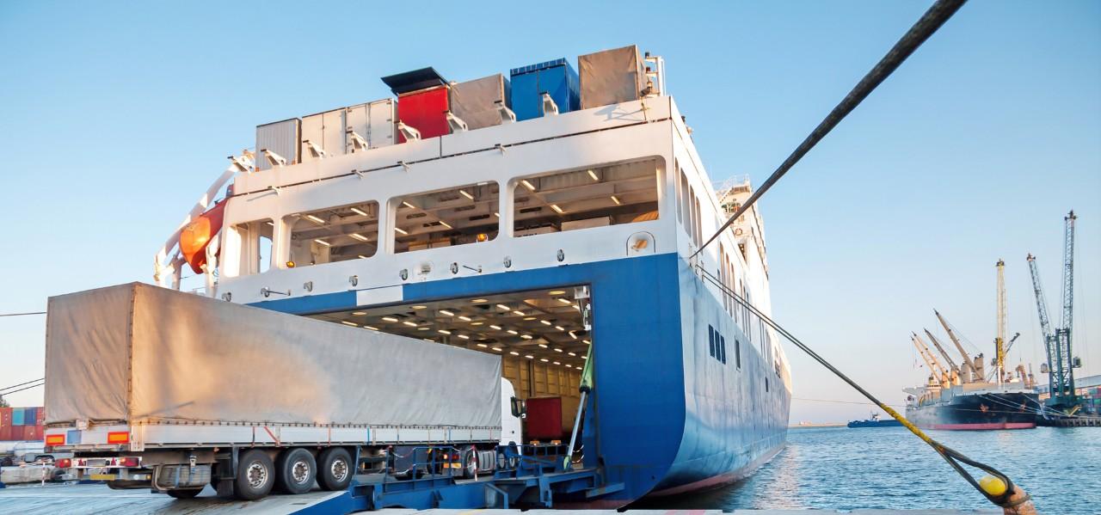
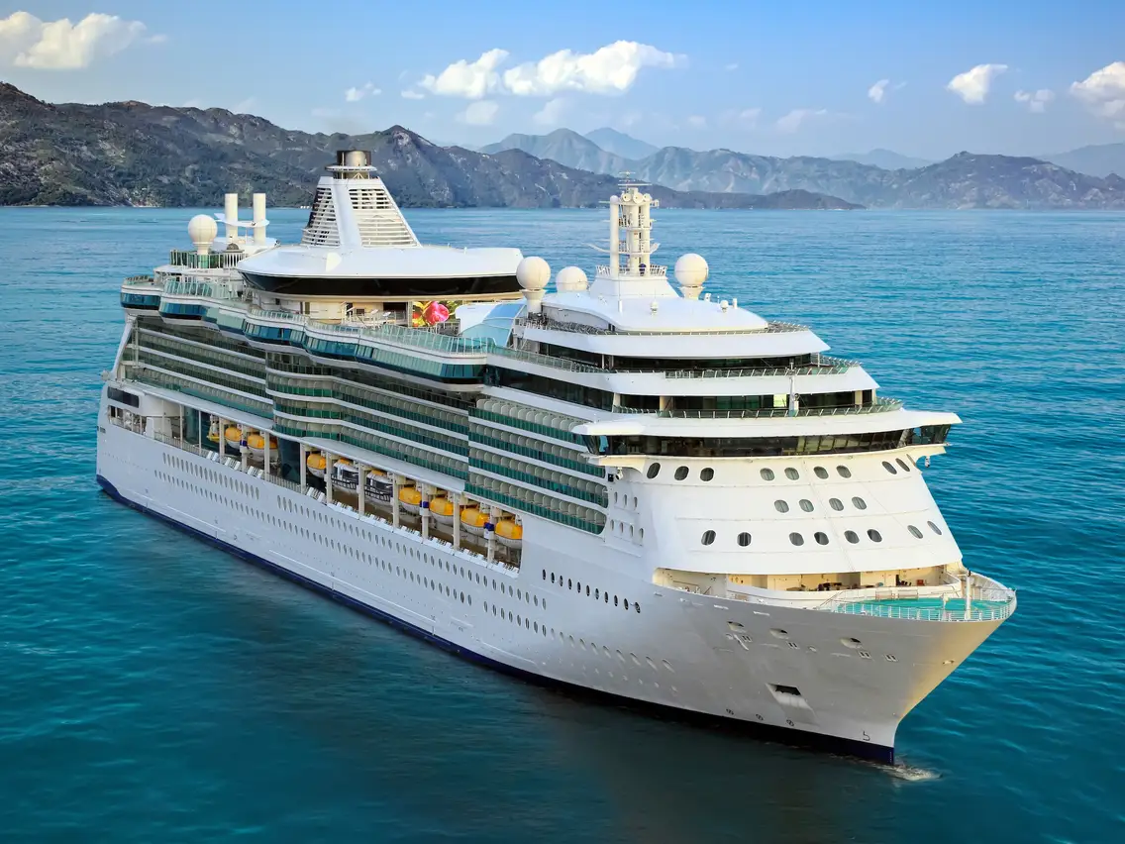
p.73 Other types of ships
The Ro-ro or roll-on roll- off vessel
It is a special cargo vessel with huge stern doors which are lowered to make a bridge from the ship to the wharf. There are two types, the passenger Ro-ro and the cargo Ro-ro. Modern car-passenger ferries operate on short- sea routes.
Cruisers of cruise ships
They offer more luxury and style to holiday makers. They have several decks in their large superstructure above the uppermost continuous deck to provide accommodation, dining rooms, lounges, restaurants, theatre, shops, swimming pools, promenade decks, etc.
Multi- purpose carriers
They transport different kinds of cargo. Many of them are geared vessels, equipped with their own cargo cranes for loading and discharging. Hatch openings are designed to fit standard container sizes.

Slide 26
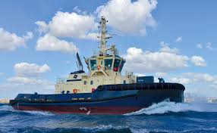
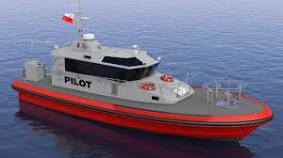
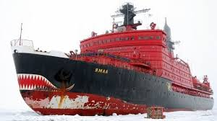
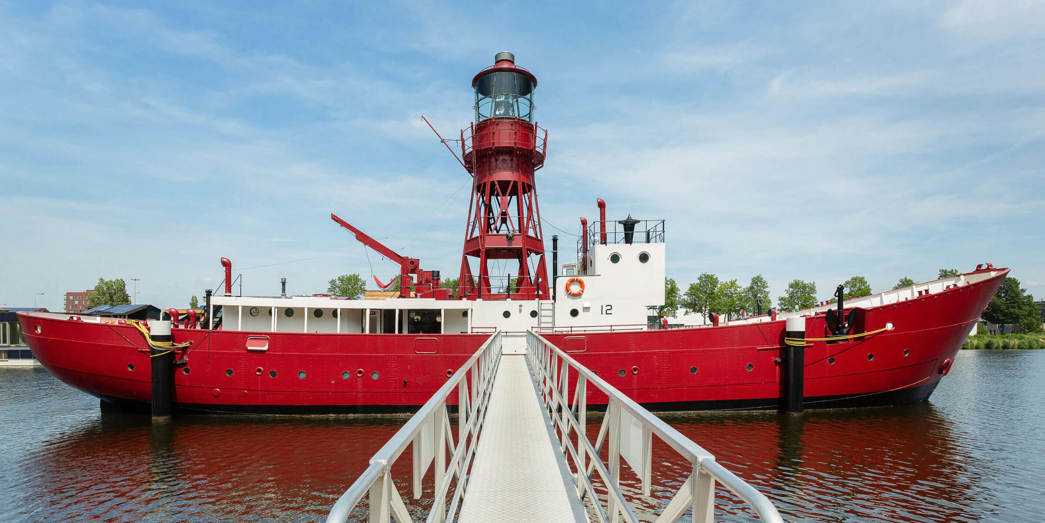
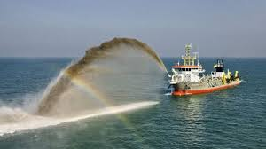
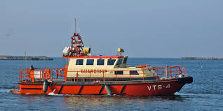
p. 76,77
Seagoing Tugs
They used for salvage, towing, anchor handling in the offshore industry.
Escort tugs operated in confined coastal waters and are small seagoing tugs that can push or pull a large ship away from a dangerous waters.
VTS vessels or Vessel Traffic Service vessels control the shipping using a shore-radar system and radio communication.
Reefers are ships with refrigerators.
Icebreakers are used to break ice.
Dredgers are designed for dredging harbors or other bodies of water.
Pilot ships are used to transport maritime pilots between land and the inbound or outbound ships that they are piloting.
Lightships are ships that act as lighthouses.

Slide 27
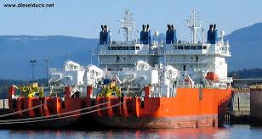
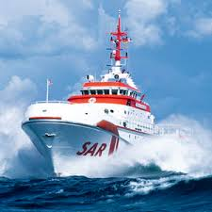
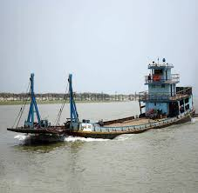
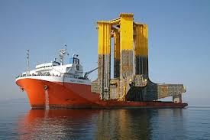
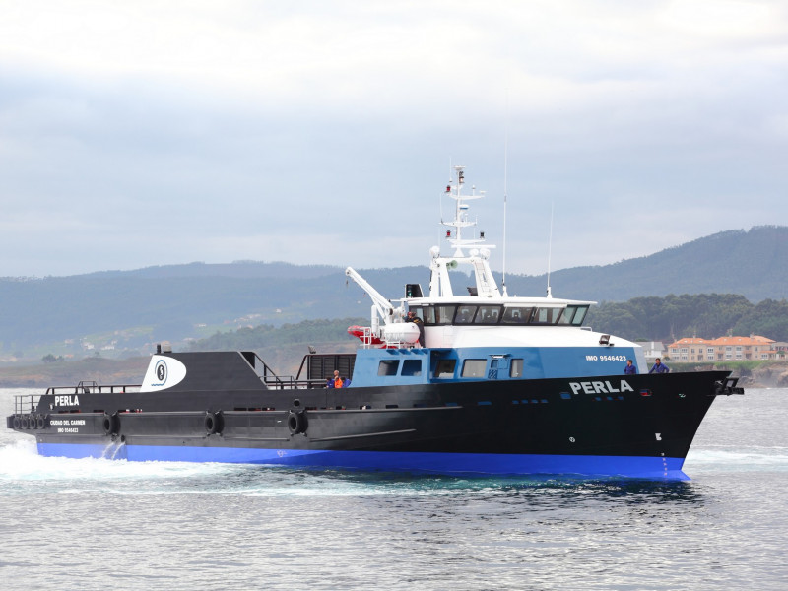
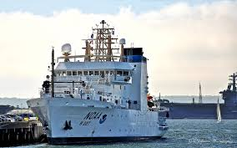
Other types of ships
A weather ship, or ocean station vessel, was a ship stationed in the ocean for surface and upper air meteorological observations for use in weather forecasting.
A SAR vessel is used for search and rescue.
A cable layer vessel is designed to lay new cables.
A supply ship is used to bring supplies to the vessel.
A barge is a shoal-draft flat-bottomed boat, built mainly for river and canal transport of bulk goods.
A heavy-lift ship is a vessel designed to move very large loads that cannot be handled by normal ships. They are of two types:
- Semi-submersible ships that take on water ballast to allow the load—usually another vessel—to be floated over the deck, whereupon the ballast is jettisoned and the ship's deck and cargo raised above the waterline.
- Project cargo ships that use at least one heavy-lift crane for handling heavy cargo and sufficient ballast to assure stability and sea-keeping properties.

Slide 28
p.78,79

Slide 29
answers
C. forecastle, holds, bosun store, laundry, mooring, quay, embarkation, rudder, heading
E. Containers, bulk, knots, TEU, capacity, width, length, route, vessel
F. Search and rescue, rescue coordination center, twenty equivalent unit, vessel traffic service, very high frequency, public address system, estimated time of arrival, ETD estimated time of departure, global positioning system

Slide 30
p. 80 also found in IMO book

Slide 31
Answers bow, ahead, tug, forecastle, starboard bow, forward, starboard, bridge, aft, starboard quarter, stern, astern, port quarter, port, port bow

